Slide 1
Novel Approach to Construction and Maintenance of Tetrahedral Formation
9th International Workshop on Satellite Constellations and Formation Flying, Boulder, CO, 19-21 June 2017
Mikhail Koptev
Yaroslav Mashtakov
Mikhail Ovchinnikov
Sergey Shestakov
Keldysh Institute of Applied Mathematics, Moscow, Russia

Slide 2
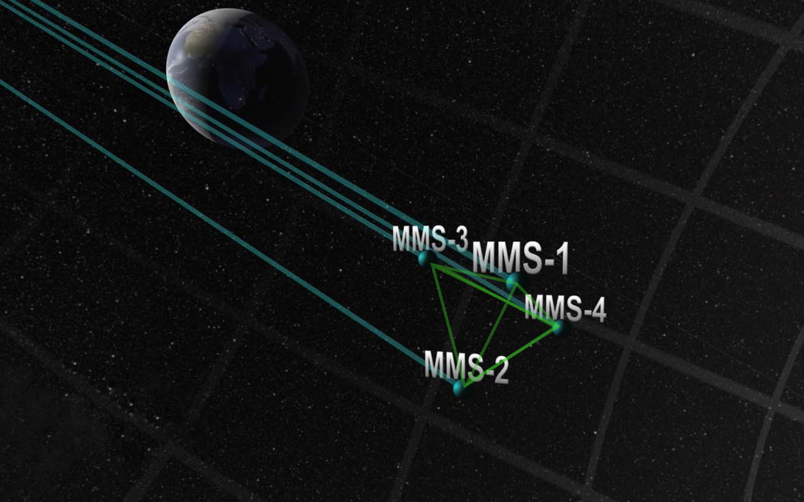
Tetrahedral formation
Earth’s magnetic field study, Space Research Institute of RAS
Magnetospheric Multiscale Mission
picture from www.nasa.gov
9th IWSCFF, Boulder, 19-21 June 2017

Slide 3
Problem statement
Given four satellites on closed, possibly elliptical, orbits
Need to obtain a reference orbit in order that the volume and shape of the corresponding tetrahedron maintain over time
Size and shape must be formalized
Also provide a control algorithm for several satellites to neglect perturbations
9th IWSCFF, Boulder, 19-21 June 2017

Slide 4
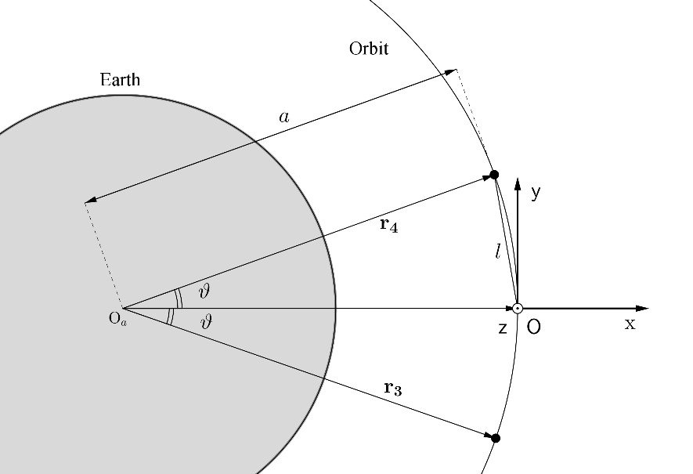
Problem statement
Two satellites move passively along the same orbit
The other two equipped with some control device e.g. magnetic attitude control system and thrusters
9th IWSCFF, Boulder, 19-21 June 2017

Slide 5
Tetrahedral configuration
Quality of the tetrahedron
Volume conservation is the conservation of the size
Quality conservation is the conservation of the shape
Quality is chosen to be meaningful in geometric sense and analytically analyzable
9th IWSCFF, Boulder, 19-21 June 2017

Slide 6
Reference orbit for circular motion
Linearized HCW model, closed orbits estimation
The main goal is to find such reference orbit that in passive motion in linearized model volume and quality of the tetrahedron remain constant
9th IWSCFF, Boulder, 19-21 June 2017

Slide 7
Reference orbit for circular motion
Volume conserving conditions: relative orbits of controllable satellites must lie in parallel planes
The reference orbit so that volume and quality of the tetrahedron conserve
9th IWSCFF, Boulder, 19-21 June 2017

Slide 8
9th IWSCFF, Boulder, 19-21 June 2017

Slide 9
Reference orbit for circular motion
Volume and quality have the form
This shape quality parameter achieves its maximal value when
9th IWSCFF, Boulder, 19-21 June 2017

Slide 10
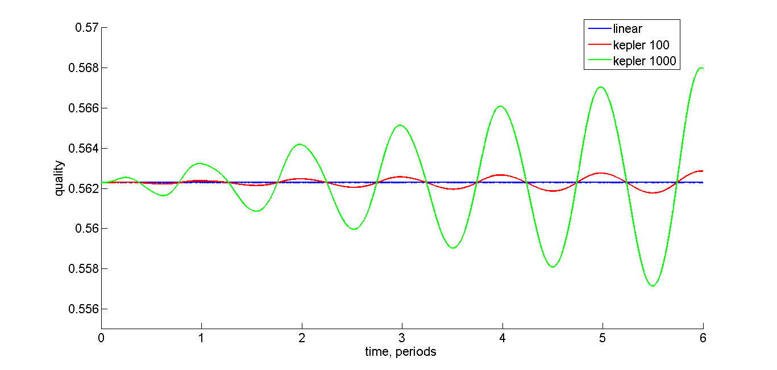
Radius 10000 km, e=0, А=100 m and A=1000 m
9th IWSCFF, Boulder, 19-21 June 2017

Slide 11
Reference orbit for elliptic motion
Solutions for corresponding linear model (TH equations)
Make reference orbit analogous to circular one
9th IWSCFF, Boulder, 19-21 June 2017

Slide 12
Reference orbit for elliptic motion
Parameters for reference orbit
9th IWSCFF, Boulder, 19-21 June 2017

Slide 13
Reference orbit for elliptic motion
In this case quality has the form
Choose coefficients A, B, and C, so that minimum over period be maximal
9th IWSCFF, Boulder, 19-21 June 2017

Slide 14
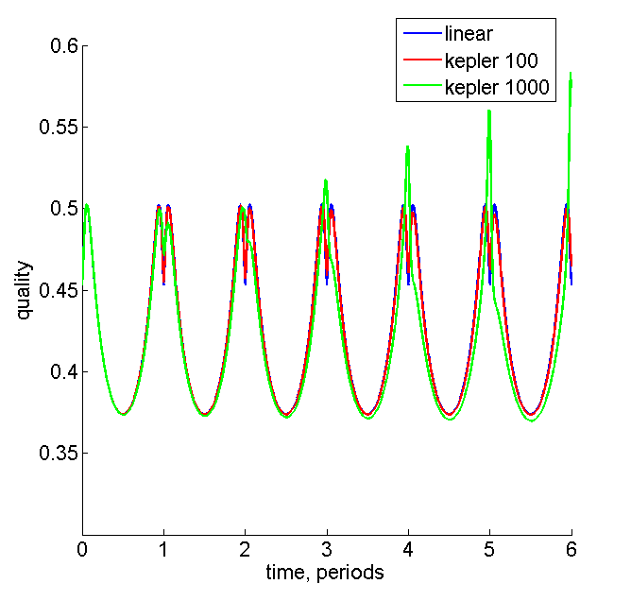
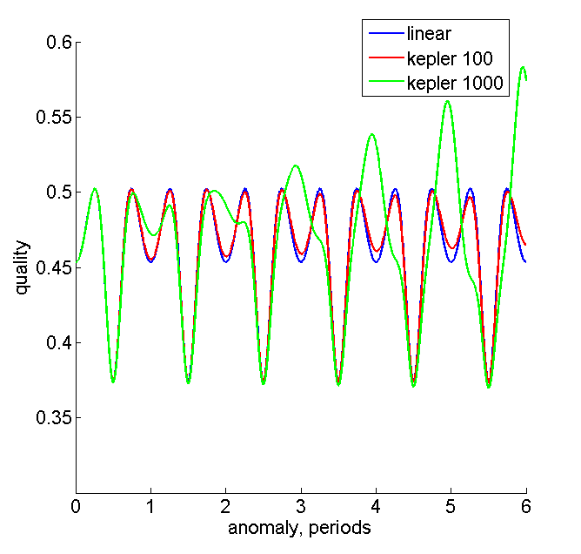
Pericenter 10000 km, apocenter 50000 km,
e=0.66, А=100 m and A=1000 m, T = 14,5 h
9th IWSCFF, Boulder, 19-21 June 2017

Slide 15
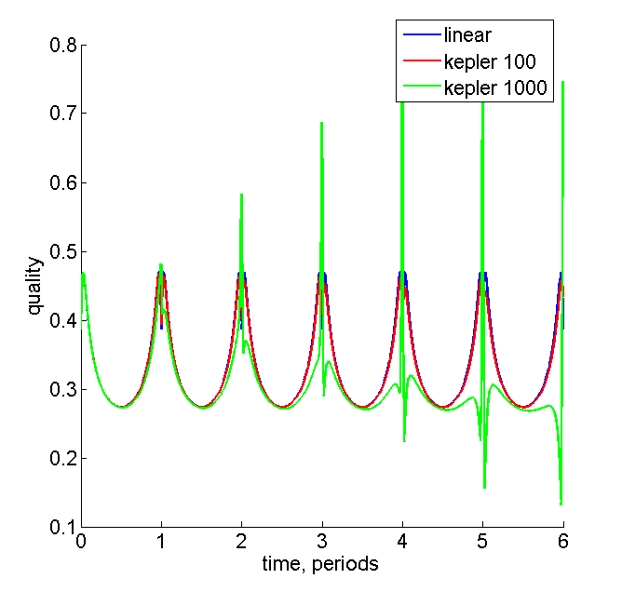
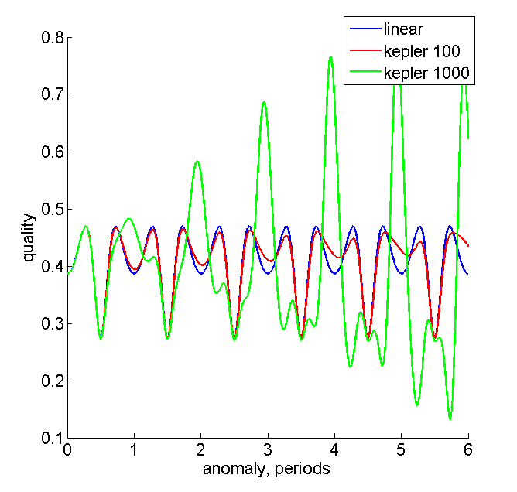
Pericenter 10000 km, apocenter 100000 km,
e=0.82, А=100 m and A=1000 m, T = 1,5 days
9th IWSCFF, Boulder, 19-21 June 2017

Slide 16
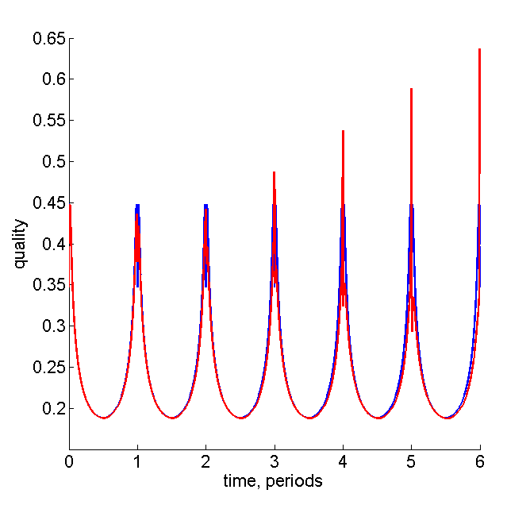
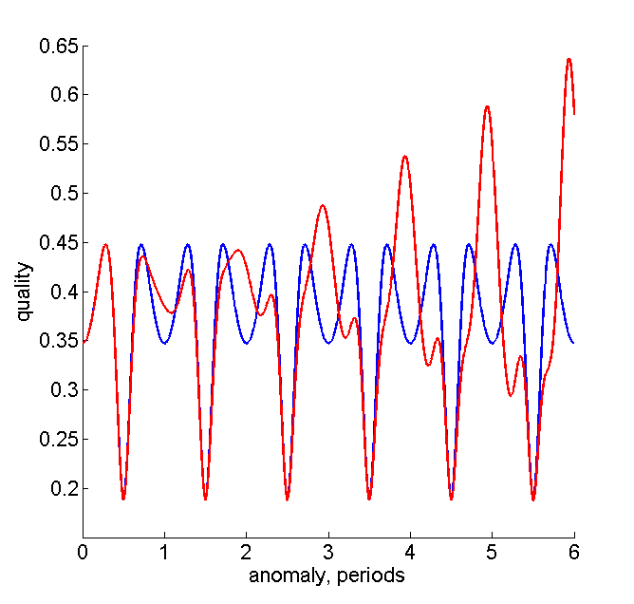
Pericenter 10000 km, apocenter 200000 km,
e=0.9, А=100 m, T = 4 days
9th IWSCFF, Boulder, 19-21 June 2017

Slide 17
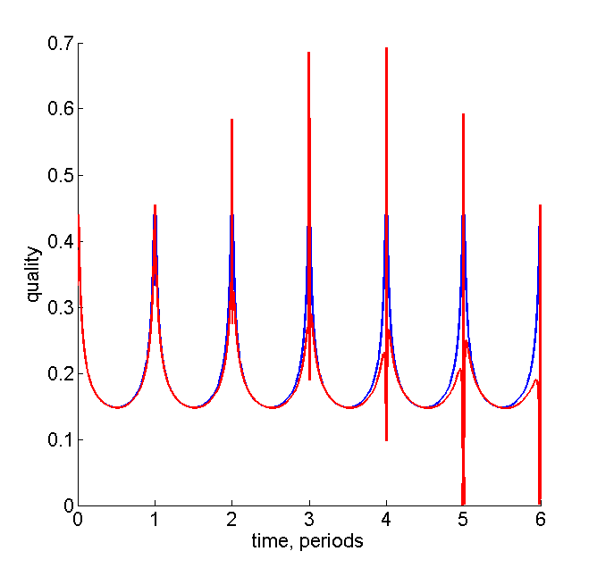
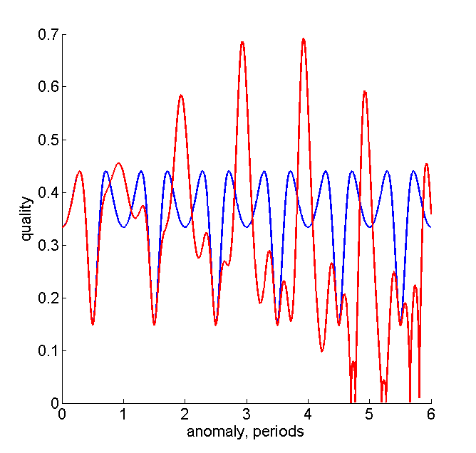
Pericenter 10000 km, apocenter 300000 km,
e=0.94, А=100 m, T = 1 week
9th IWSCFF, Boulder, 19-21 June 2017

Slide 18
Pericenter 10000 km, apocenter 200000 km,
e=0.9, А=100 m, T = 4 days
9th IWSCFF, Boulder, 19-21 June 2017

Slide 19
Two satellites control algorithm
Pontryagin’s maximum principle
Parallel shooting for boundary-value problem
9th IWSCFF, Boulder, 19-21 June 2017

Slide 20
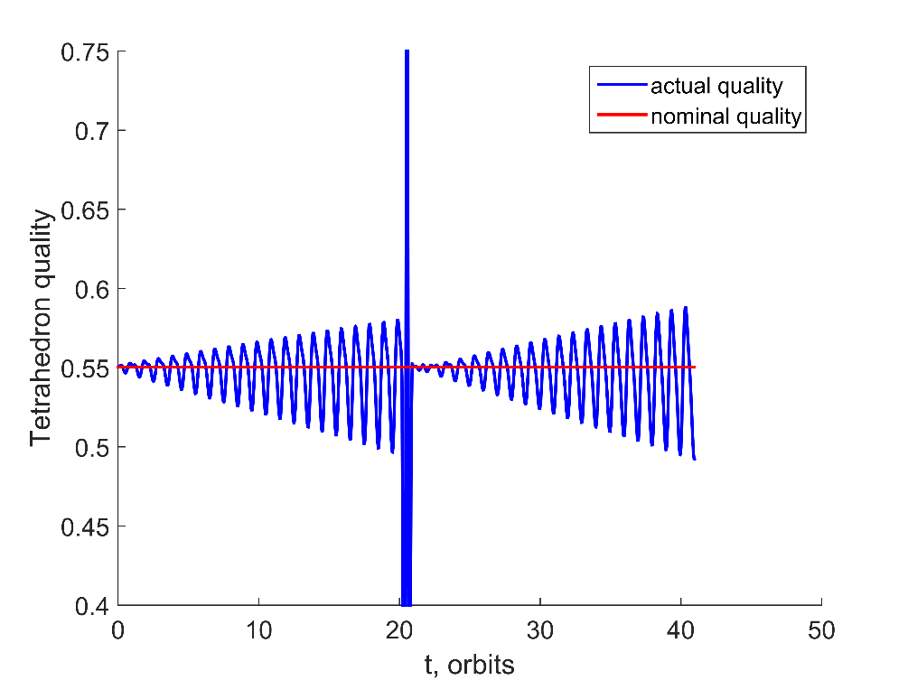
Two satellites control in circular motion
Quality degrading and compensation
20 passive revolutions
9th IWSCFF, Boulder, 19-21 June 2017

Slide 21
Conclusions
The reference orbit for 4 sats conserving volume and shape of the tetrahedron is found in linear model on circular orbit
For elliptic orbit the quality is periodic and conserves near the apocenter during several revolutions without any control
Motion control (even in the case of single-axis control) allows to maintain a configuration (0.02 – 0,17 m/s/day depending on inclination)
9th IWSCFF, Boulder, 19-21 June 2017

