Slide 1

NLTE10 Calculation results:
Comparison with experiments
D.A. Kim, A.D. Solomyannaya, I.Yu. Vichev, A.S. Grushin
Keldysh Institute of Applied Mathematics RAS, Moscow, 125047 Russia
vichevilya@keldysh.ru
Moscow, 2017

Slide 2
THERMOS code
Database: Average Atom model [1] with nmax = 6
Fitting lines with FAC [2] for configuration from [3]
References:
[1] KIAM_DB: atomic database for modeling of spectral properties of plasma 2016 /Novikov V.G. et al
[2] Gu M.F. Flexible Atomic Code (FAC) / M.F. Gu, E. Stambulchik
[3] Ionization energies of tungsten ions: W²⁺ through W⁷¹⁺ /Alexander E.Kramida & Joseph Reader

Slide 3
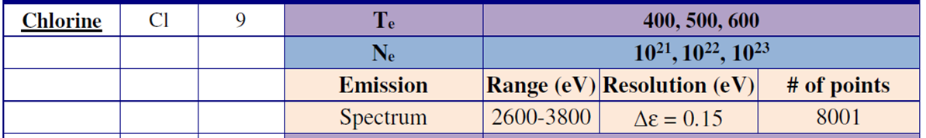
Cl: comparison with the experiment ^{[4]}
References:
[4] Beiersdorfer et al., Lineshape measurements of He-b spectra on the ORION laser facility, Phys Plas. 23, 101211 (2016)

Slide 4
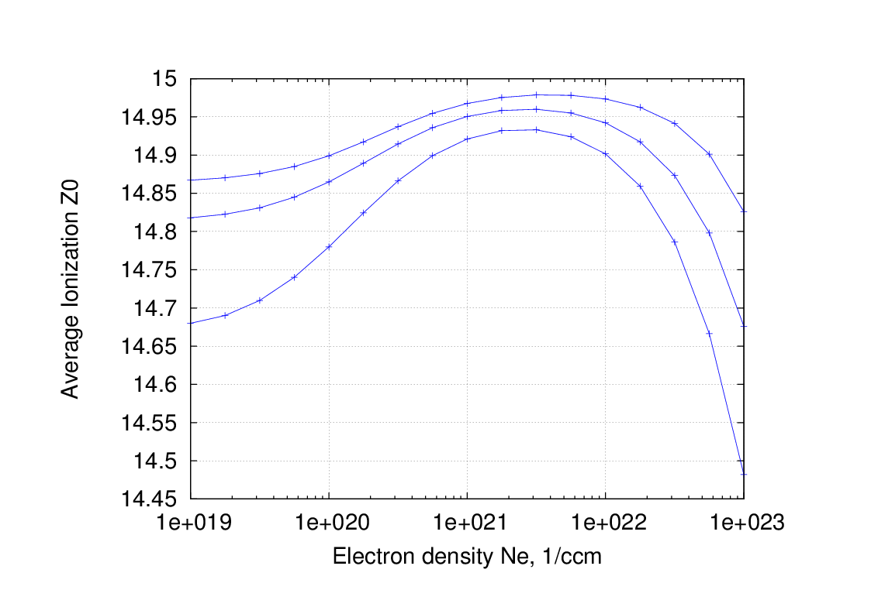
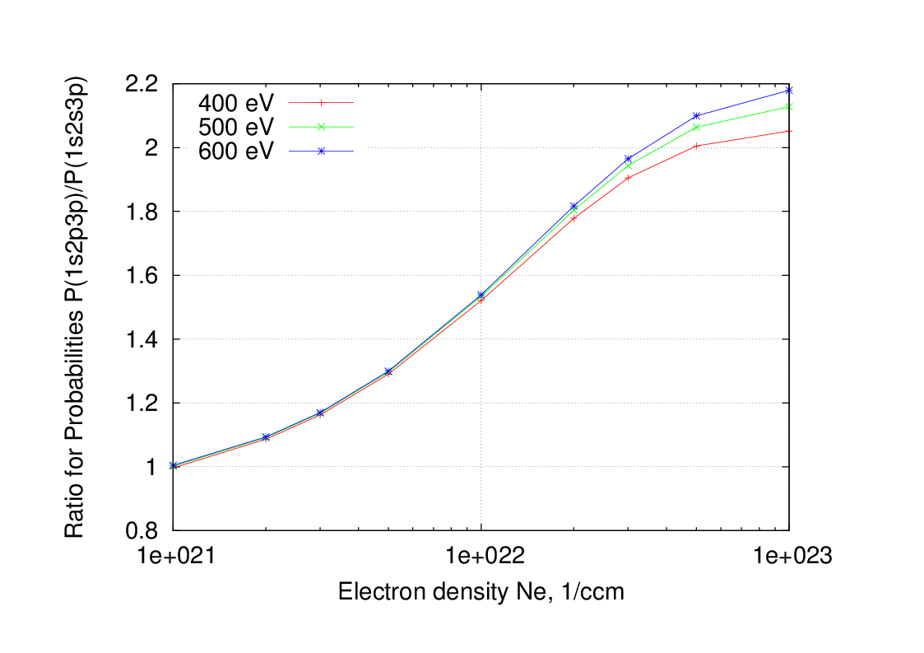
Preliminary calculation for Cl:
T = 600 eV
T= 400 eV
The plasma in experiment is near LTE

Slide 5
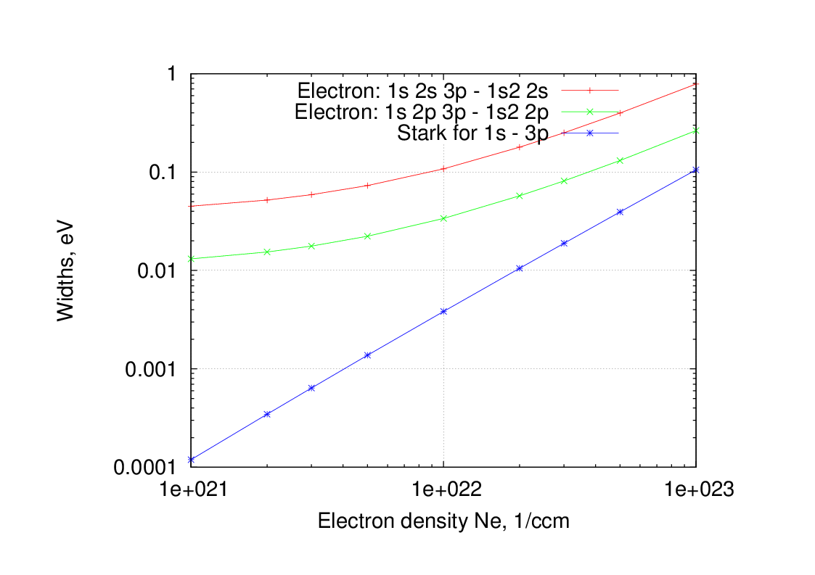
The linewidths at 600 eV
Natural widths for 600 eV
G(1s 2s 3p – 1s2 2s)= 0.004 eV
G(1s 2p 3p – 1s2 2p)= 0.016 eV
The Stark widths were estimated by 2-level approximation [5]
References:
[5] Spectral lines in hot dense matter // Rozsnyai B.F. -1977

Slide 6
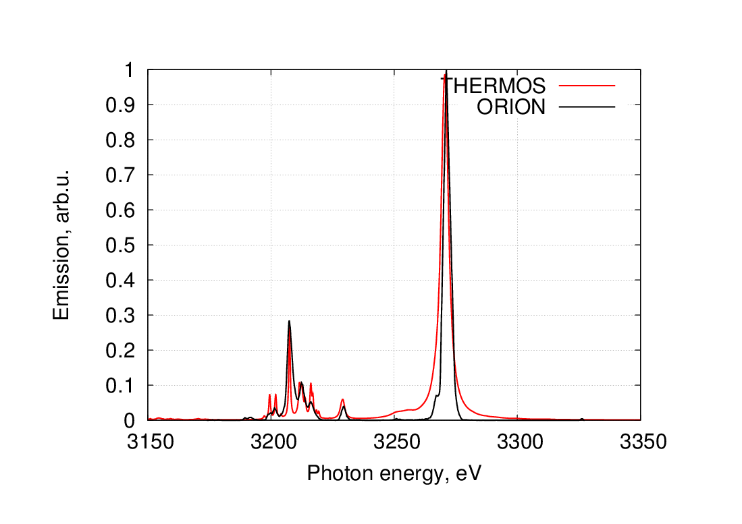
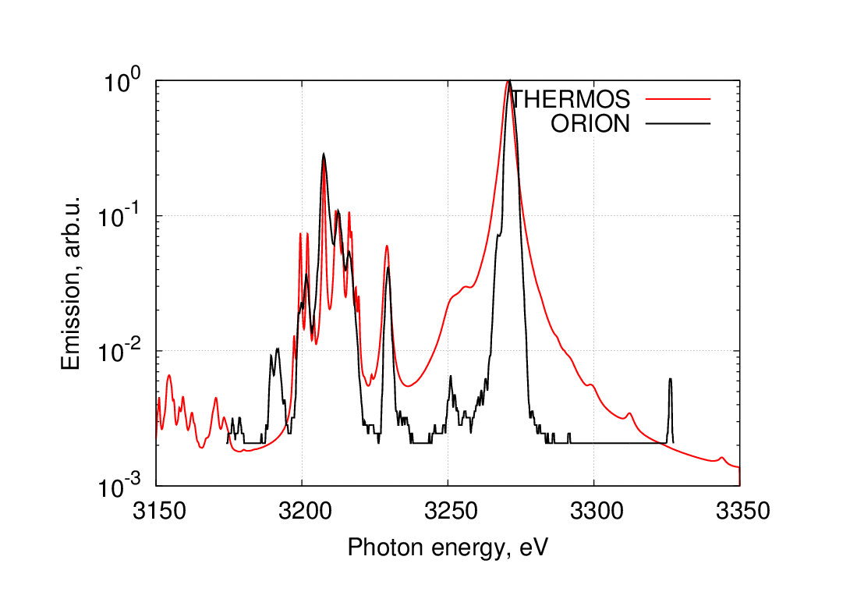
Comparison with ORION experiment [6]
To compare THERMOS calculation with experimental data following parameters were considered:
Cl : Te=600 eV; Ne=1e23 cm⁻³; L=400 nm; 3150-3350 eV; dE=0.1 eV;
References:
[6] Beiersdorfer et al., Lineshape measurements of He-b spectra on the ORION laser facility, Phys Plas. 23, 101211 (2016)

Slide 7
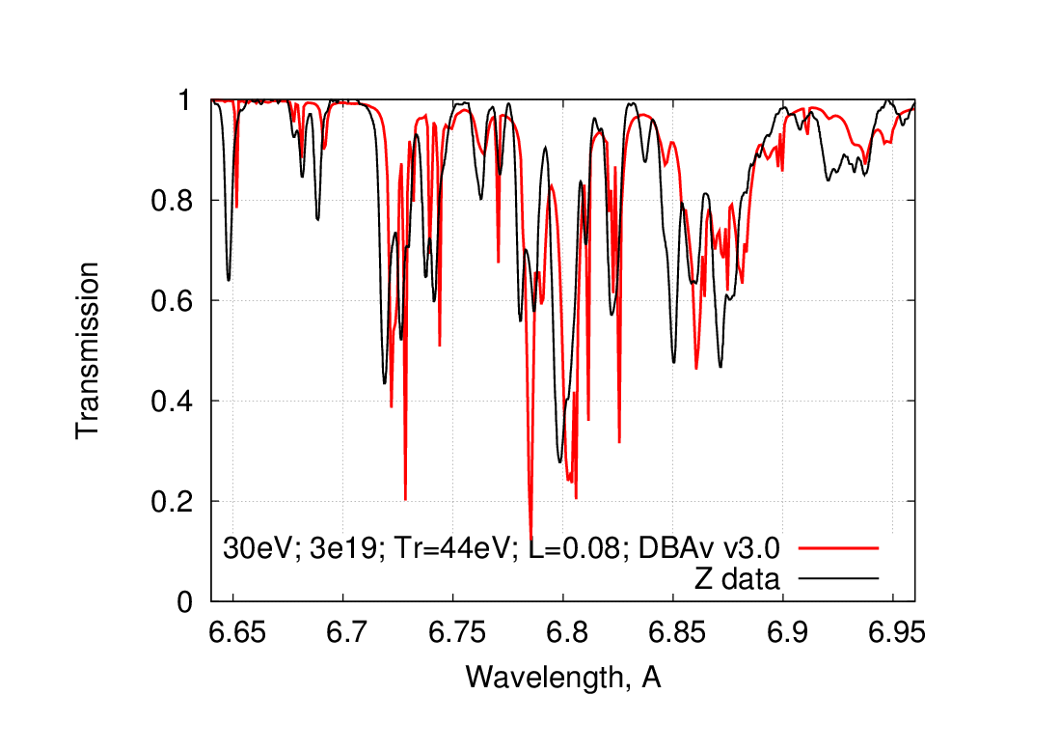
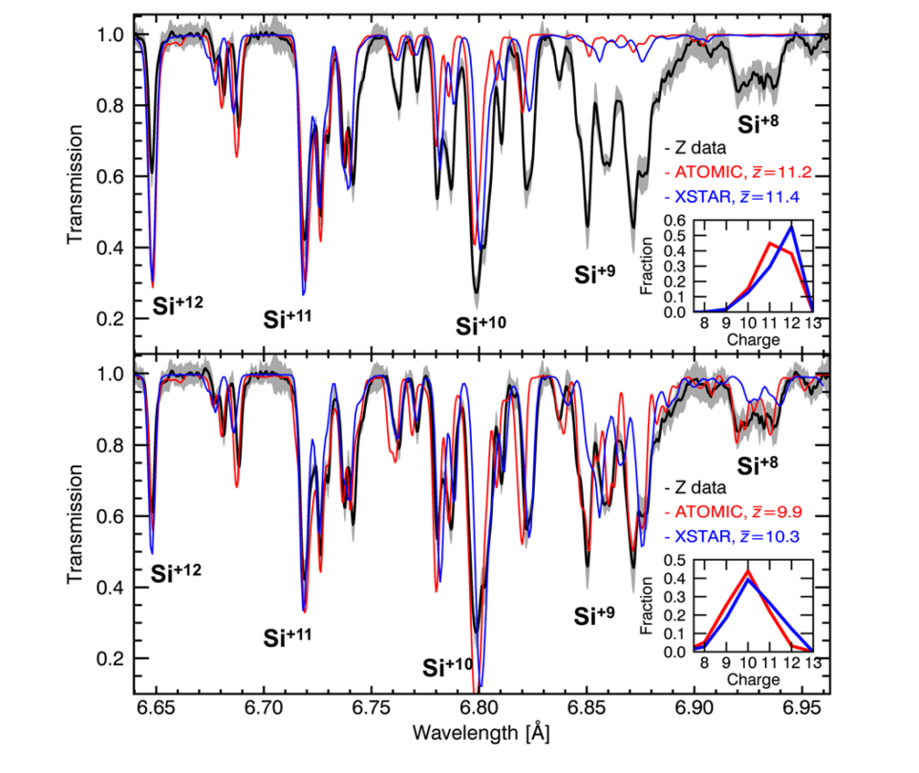
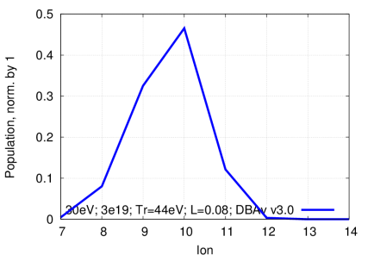
Si: comparison with the experiment^{[7]}
THERMOS
THERMOS, Z0=9.6
References:
[7] G. P. Loisel, J. E. Bailey, D. A. Liedahl, C. J. Fontes, T. R. Kallman, T. Nagayama, S. B. Hansen, G. A. Rochau, R. C. Mancini, and R. W. Lee, Benchmark Experiment for Photoionized Plasma Emission from Accretion-Powered X-Ray Sources. Phys. Rev. Lett. 119, 075001 – Published 16 August 2017

Slide 8
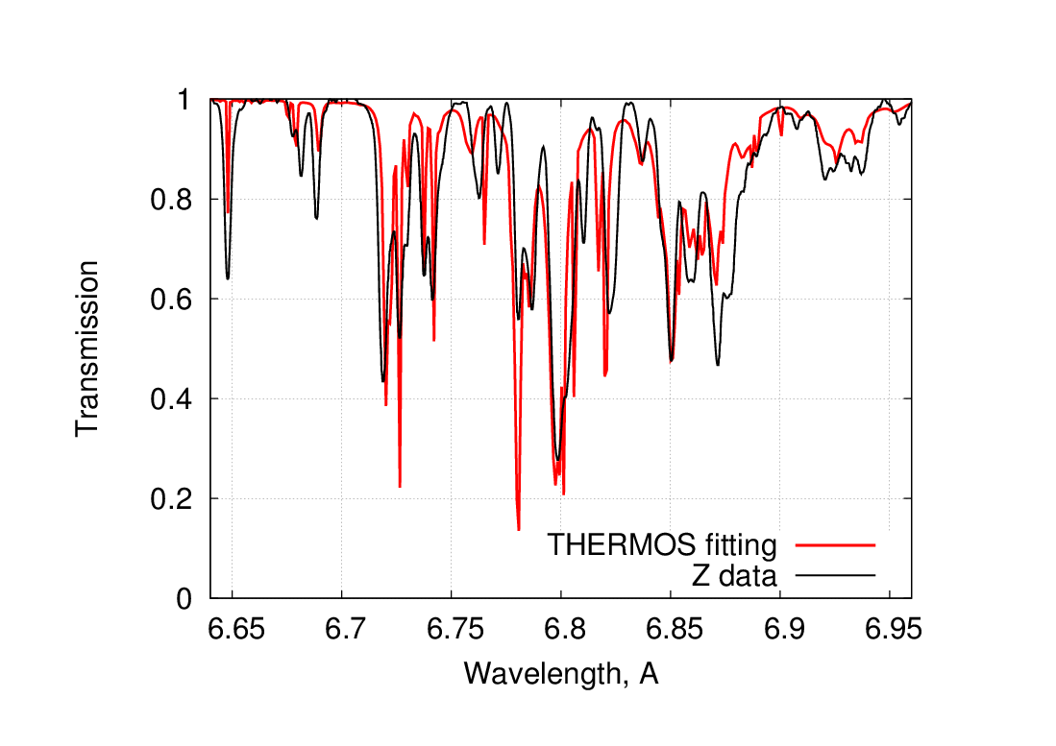
Si: Fitting lines
To compare THERMOS calculation with experimental data [7] following parameters were considered:
Si : Te=30 eV; Ne=3e19 cm⁻³; L=0.08 cm; 1700-2500 eV; dE=0.1 eV;
k | dE, eV
8 | 3.00
9 | 2.69
10 | 1.28
11 | 0.53
12 | 0.90
References:
[7] G. P. Loisel, J. E. Bailey, D. A. Liedahl, C. J. Fontes, T. R. Kallman, T. Nagayama, S. B. Hansen, G. A. Rochau, R. C. Mancini, and R. W. Lee, Benchmark Experiment for Photoionized Plasma Emission from Accretion-Powered X-Ray Sources. Phys. Rev. Lett. 119, 075001 – Published 16 August 2017

Slide 9
Acknowledgments
This work was funded by the Russian Science Foundation through grant No. 14-11-00699.

