Slide 1
Approaches to Studying the Performance of Swarm Decentralized Control Algorithms
Uliana Monakhova, Danil Ivanov, Yaroslav Mashtakov, Sergey Shestakov
Keldysh Institute of Applied Mathematics of RAS
Notes:
Good afternoon everyone
My name is Uliana and I want to present you our work approaches to studying the performance of swarm decentralized control algorithms

Slide 2
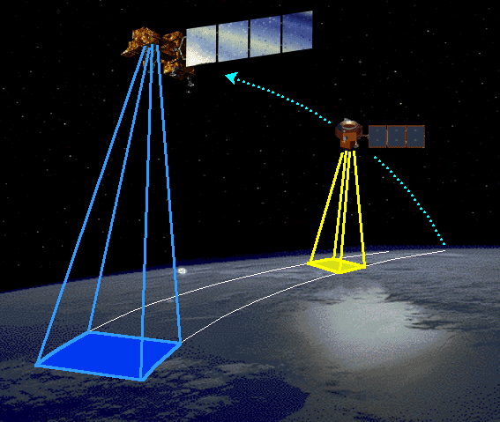
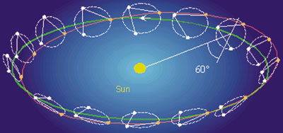
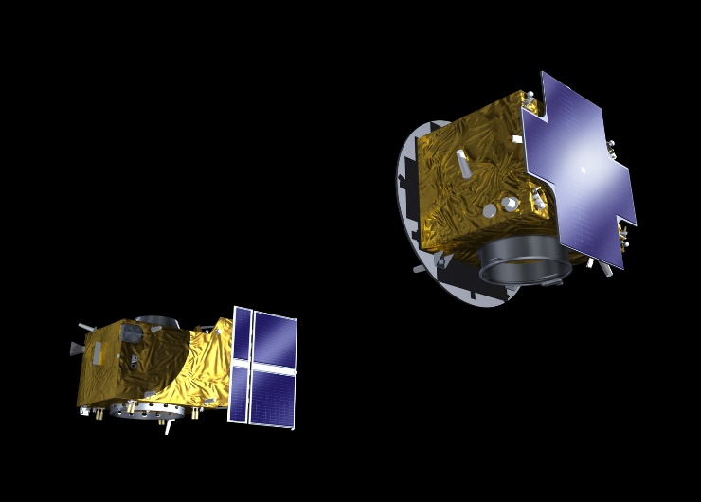
Satellite formation flying applications
Earth remote sensing
Gravitational waves detector
Solar coronagraphy
Magnetic field measurements
Measurements of Earth's gravity field
Landsat 7 & EO-1 Credit: NASA
LISA Credit: ESA
Proba-3 Credit: ESA Portal
Notes:
Let me start by saying a few words about the relevance of the topic
Nowadays Formation flying can solve different ambitious tasks from earth remote sensing to taking measurements of earth gravity field
Here in the pictures you can see some examples of formation flying missions
And in all this missions the relative motion control of satellites is of special interest

Slide 3
Problem statement
After the launch of 3U CubeSats from the launcher construct a swarm, i.e. the achievement of closed relative trajectories is required
Satellites separate from the launch vehicle one after another with the time interval between the launches
Each satellite is equipped with a relative motion determination system able to estimate the translational motion of any neighbour satellite within the communication area
Communication area
Notes:
I will talk about decentralised control application to a problem of satellites swarm construction after the launch The launch presents the separation of satellites in consecutive order in the same direction (from the launch vehicle) (as it is shown in the video) Also, we consider that all satellites are equipped with relative motion determination system able to estimate the motion of any satellite inside the communication area
And Communication area we determine as a sphere with particular radius centered in the center of mass of the satellite

Slide 4
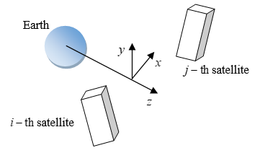
Relative motion model
Hill-Clohessy-Wiltshire equations:
Consider control to eliminate the drift component
In case of controlled motion parameters are defined by differential equations:
Reference frame
Relative drift
Notes:
First i would like to consider the equation of relative motion From the solution of this equations we can note that along the parameter C leads to the relative drift of the satellites which can be the cause of separation of the group
And if you look at the graph below you will see how relative drift increases with the time
So let's take the parameters in the solution as independent variables and see how they change over time also taking into account the value of control acceleration u
The differential equation for the drift parameter C shows that it is effected only by Ox component of acceleration
That’s why we will consider control application only along Ox axes and it will include average value of drifts that are determined inside the communication area of specific satellite

Slide 5
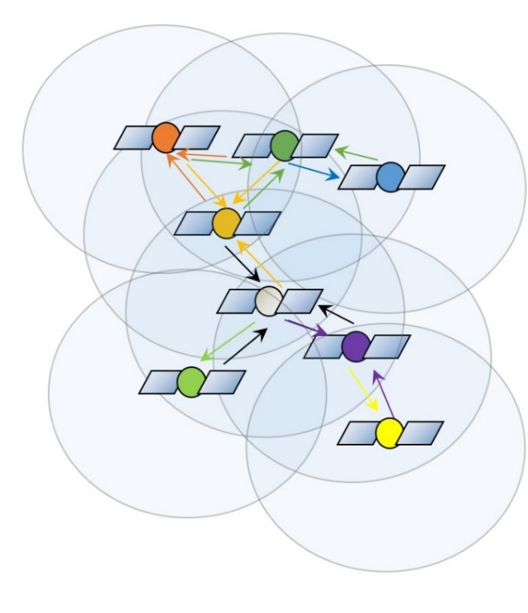
Communication graph and convergence rate
Connected graph of satellites
Zero is always an eigenvalue
All nonzero eigenvalues are strictly negative
Notes:
Further I would like to consider the control in more detail
The values of average drifts relative to every satellite in the group can be presented in the matrix form where the components of the matrix S with cover depends on the amount of satellites that are seen in the communication area of every satellite
On the other side, this problem can be presented in terms of graph theory
So, our swarm can be illustrated by the graph where all the vertices are satellites and connections between them are edges
From this point of view matrix S is similar to normalized laplacian matrix via the degree matrix as it shown on the slide
It means that spectra of these matrices are the same
If the graph is connected it is known for the laplacian matrix that zero is always an eigenvalue and all nonzero eigenvalues are strictly negative
In other words chosen control will provide asymptotic stability if the swarm is connected

Slide 6
Dependence of communication radius on the launch parameters
Notes:
Developed magnetic interaction influences not only relative translational motion but also angular motion
Torque produced by magnetic interaction leads to increase of satellites angular momentum
That is why when we don’t control relative position we can use magnetorquers for angular velocity damping according to well-known –Bdot algorithm

Slide 7
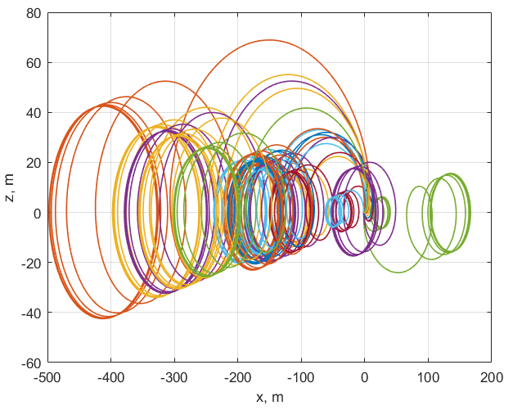
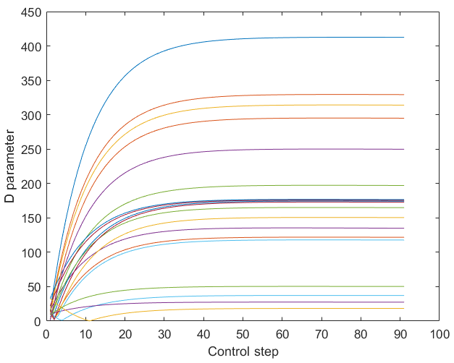
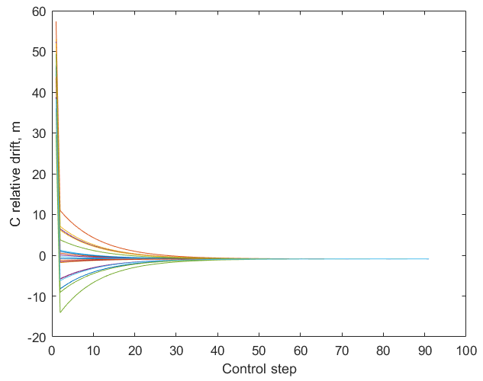
Numerical simulation results
Relative trajectories under proposed control
D parameter
Relative drifts during the simulation
Notes:
This video shows the work of decentralized control algorithm
We can see relative positions of 20 chipsats with respect to the one from the group and also the changes of the attitude during the simulation
At the end all the satellites are distributed over volume of about 4 cubic meters with relative distances about half a meter

Slide 8
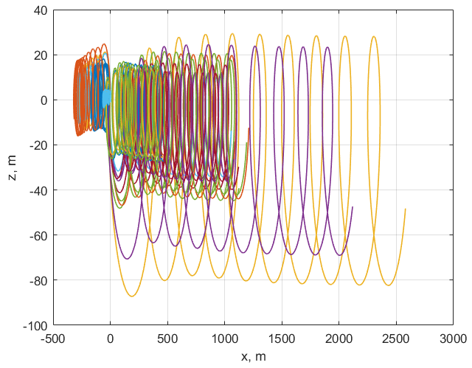
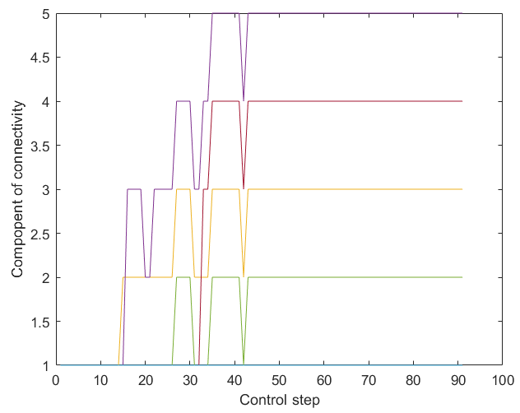
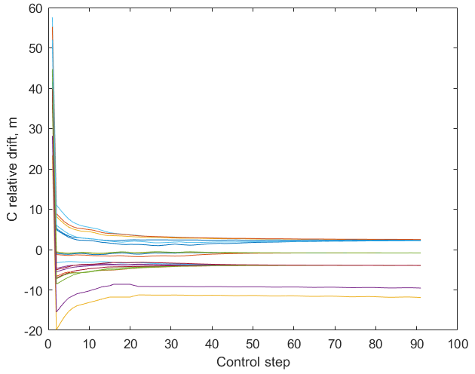
Numerical simulation results
Relative trajectories under proposed control
Connectivity component of graph
Relative drifts during the simulation
Notes:
These graphics show the change of relative drifts and angular velocities of chipsats during the simulation

Slide 9
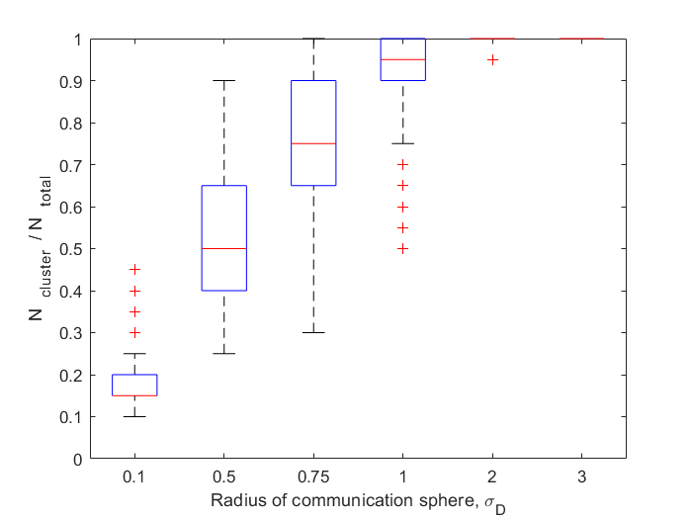
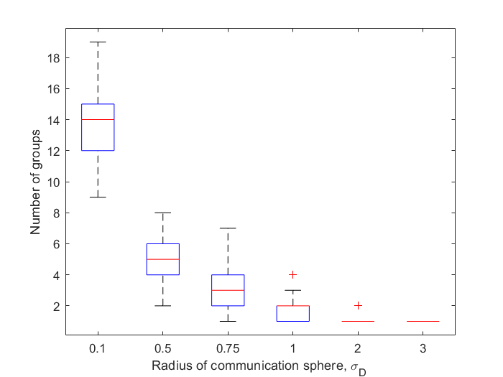
Dependence on the radius of communication sphere
Notes:
Further on, increasing initial velocity we also see we obtain the decrease in number of satellites managed to eliminate the drift
This connected with restriction on dipoles that can be developed by magnetorquers

Slide 10
Conclusions
The application of decentralized control based on the motion of satellites inside the communication sphere makes possible to construct a swarm of satellites
The radius of communication sphere necessary for keeping swarm connected depends on initial parameters
Numerical results obtained in Monte Carlo simulations support the analytical estimations of radius
Notes:
To sum up, here are main conclusions that can be made from the showed results

Slide 11
Thank you for attention!
Our web-site:
http://keldysh.ru/microsatellites/eng/

