Slide 1
Квалификационная работа на соискание степени магистра Построение, выведение и поддержание тетраэдральной формации наноспутников на высокоэллиптических орбитах
МОСКОВСКИЙ ФИЗИКО-ТЕХНИЧЕСКИЙ ИНСТИТУТ (государственный университет)
Базовая организация: институт прикладной математики им. М. в. Келдыша ран
кафедра математического моделирования и прикладной математики
Выполнил
студент группы 272в
Коптев М.Д.
Научный руководитель
к.ф.-м.н., н.с.
Трофимов С.П.
Notes:
Greetings everyone, my name is Michael Koptev, I am from Keldysh Institute of Applied mathematics, which is located in Moscow. Today I’m pleased to present you my research about Design and Deployment of Nanosatellite-Based Formation on the Highly Elliptical Orbit .

Slide 2
Научная постановка задачи
Исследование магнитосферы Земли
Для измерений нужна формация КА в виде тетраэдра
Геометрия формации деградирует со временем

Slide 3
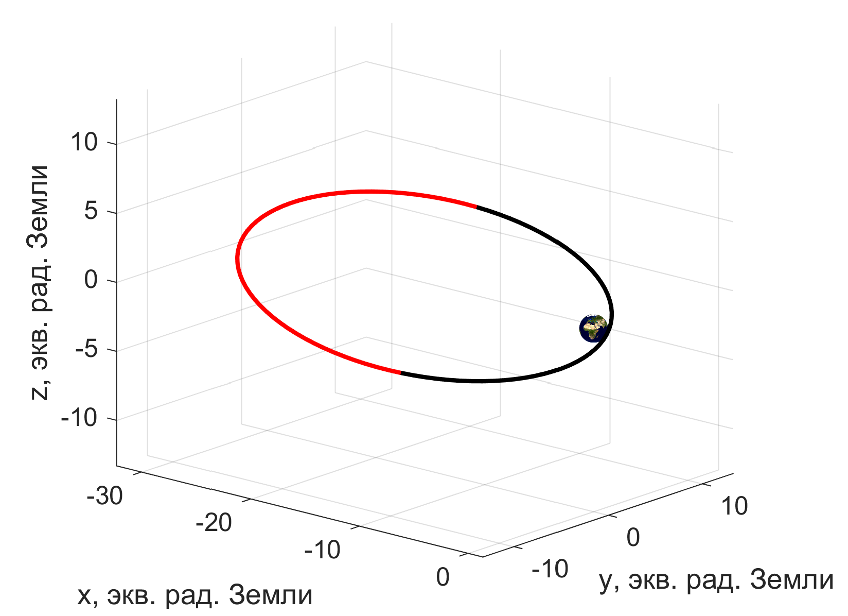
Опорная орбита
Высокоэллиптическая орбита
, старт с Байконура
Область интереса:
Возмущения: J2, Луна, Солнце
Notes:
The highly elliptical reference orbit was chosen to be similar with the one used in the second phase of MMS mission. The apogee distance was set to two hundred thousand kilometers, and the perigee is two thousand kilometers.
Inclination is fifty one-point-six degrees, assuming the mission start from Baikonur.
The longitude of the ascending node was set to zero to minimize the angle between orbital plane and the Plane of Ecliptic.
Periapsis was also set to zero, which means that the orbit apogee is placed in the center of magnetotail on the vernal equinox day.
As we intend to make measurements in the magnetotail, we will only try to keep formation in the remote region of interest (red on the picture). It consists of points, distanced from the Earth for more than 15 Earth radii (approx. 95 thousand kilometers).
Non-sphericity of Earth and perturbations due to the Moon and the Sun are considered in orbits propagations, as those perturbations have great influence on formation quality.

Slide 4
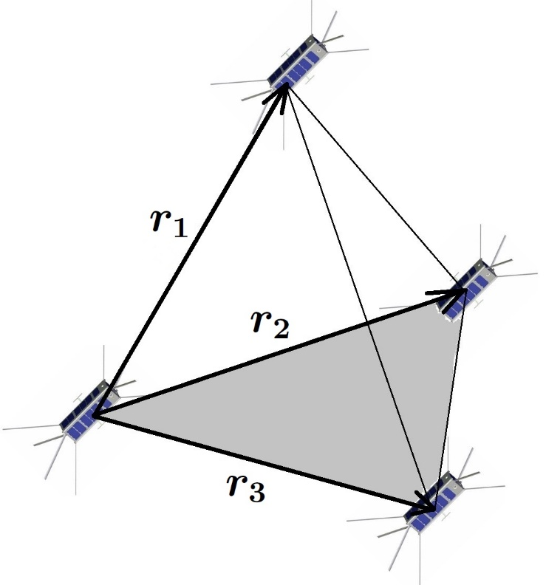
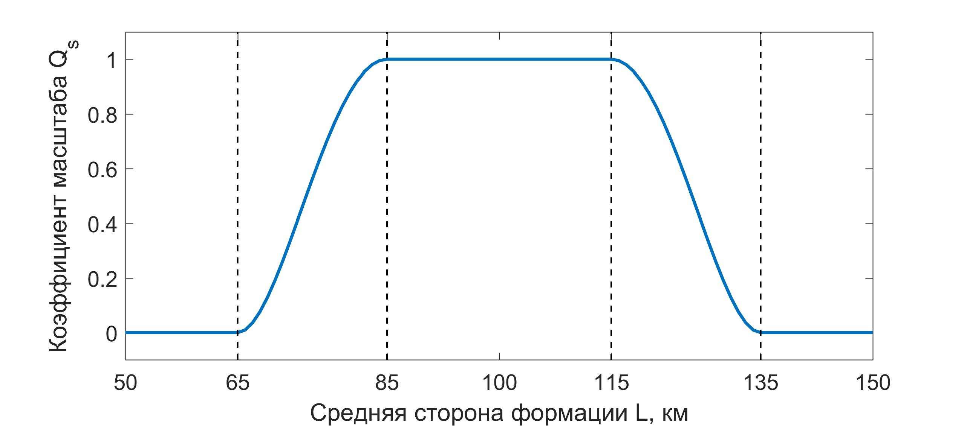
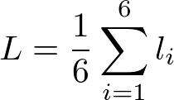
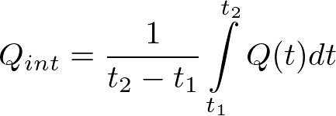
Функционал качества формации
График
Notes:
A few words should be said about estimation of the formation geometry. The method from MMS-devoted papers was used. In it, there are two factors, (point!), which measure tetrahedron size and shape independently on the scale from 0 (Zero) to 1 (one). They are then multiplied to obtain overall tetrahedron quality factor. Since our goal is to maintain the formation in the RoI, we also use the integral formation quality factor showed here (point!). It allows to examine the tetrahedron quality over the period of time. It also should be noted that different missions may require different tetrahedron scales, MMS itself used scales from 30 400 kilometers. In this particular work we set 100km (one hundred kilometers) as ideal edge length of the tetrahedron.

Slide 5
Постановка задачи
Найти оптимальные орбиты для каждого из четырех КА для максимизации числа орбитальных витков с приемлемым ( ) качеством формации
Предложить способ выведения спутников формации на найденные орбиты
Рассмотреть возможные методы продления срока существования формации
Notes:
The purpose of this work is to find optimal initialization parameters for each of the four spacecraft near the reference orbit to maximize the number of orbital revolutions with acceptable formation quality. The quality is considered acceptable if the integral formation quality factor at a given revolution exceeds 0.7 (zero-point-seven). Then, we should examine different options of formation deployment in the orbits found.

Slide 6
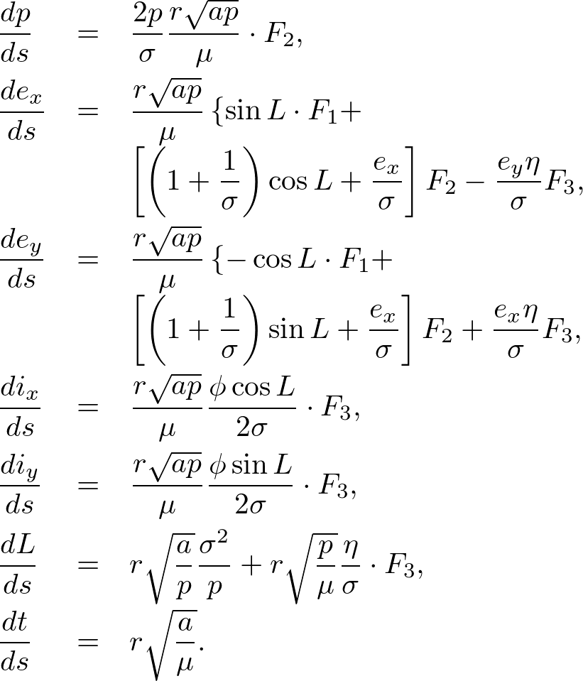
Инструментарий
Уравнения движения КА
Равноденственные элементы
Регуляризация
Численное интегрирование
Matlab (ode45, ode113)
C++ (boost, dopri5)
Оптимизация
Matlab (fmincon)
C++ (pagmo)
Суперкомпьютер К-60

Slide 7
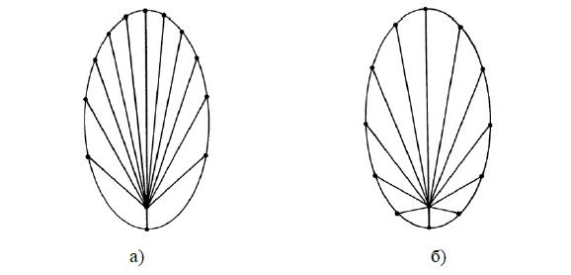
Инструментарий
Уравнения движения КА
Равноденственные элементы
Регуляризация
Численное интегрирование
Matlab (ode45, ode113)
C++ (boost, dopri5)
Оптимизация
Matlab (fmincon)
C++ (pagmo)
Суперкомпьютер К-60
Распределение 12 точек орбиты, равностоящих по а) средней аномалии б) эксцентрической аномалии

Slide 8
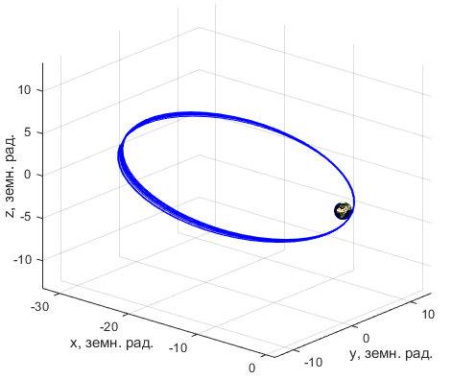
Инструментарий
Уравнения движения КА
Равноденственные элементы
Регуляризация
Численное интегрирование
Matlab (ode45, ode113)
C++ (boost, dopri5)
Оптимизация
Matlab (fmincon)
C++ (pagmo)
Суперкомпьютер К-60
Траектория движения КА в окрестности опорной орбиты

Slide 9
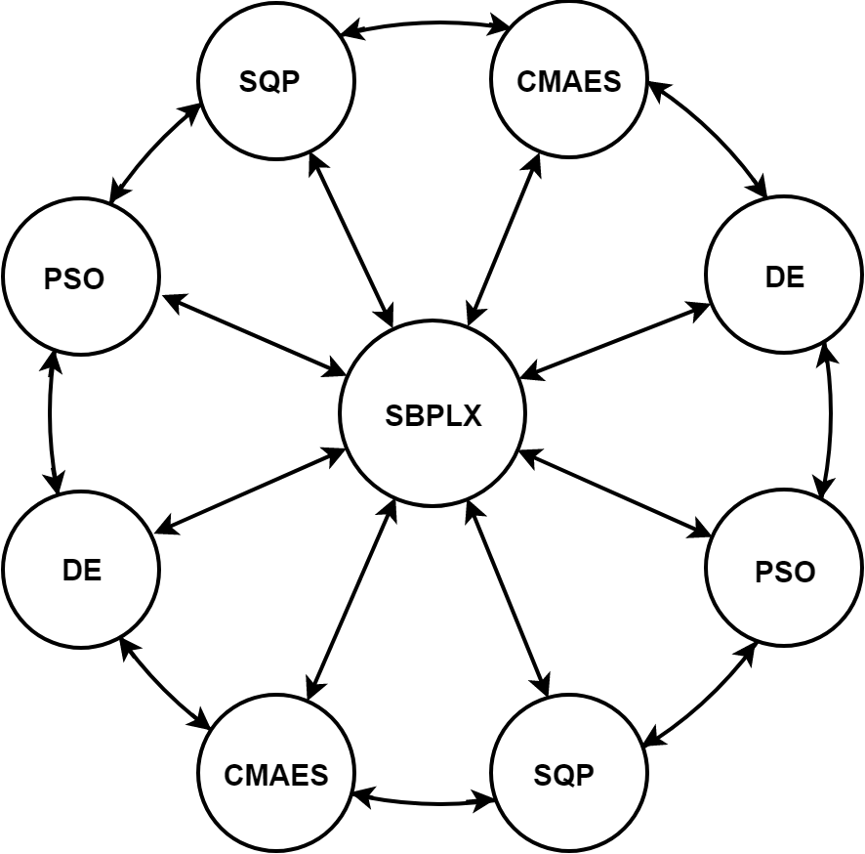
Инструментарий
Уравнения движения КА
Равноденственные элементы
Регуляризация
Численное интегрирование
Matlab (ode45, ode113)
C++ (boost, dopri5)
Оптимизация
Matlab (fmincon)
C++ (pagmo)
Суперкомпьютер К-60
Островная модель оптимизационного процесса

Slide 10
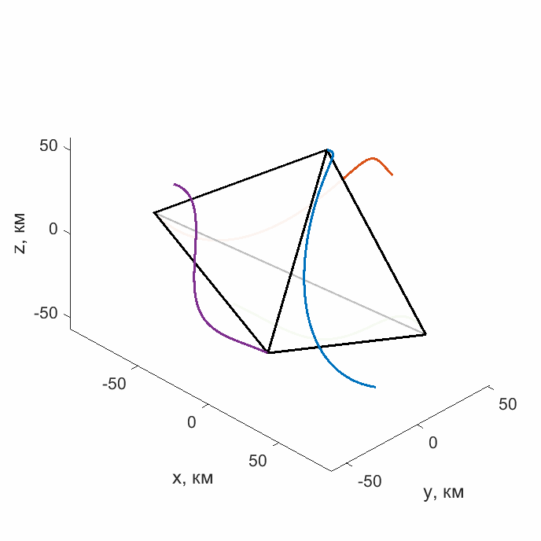
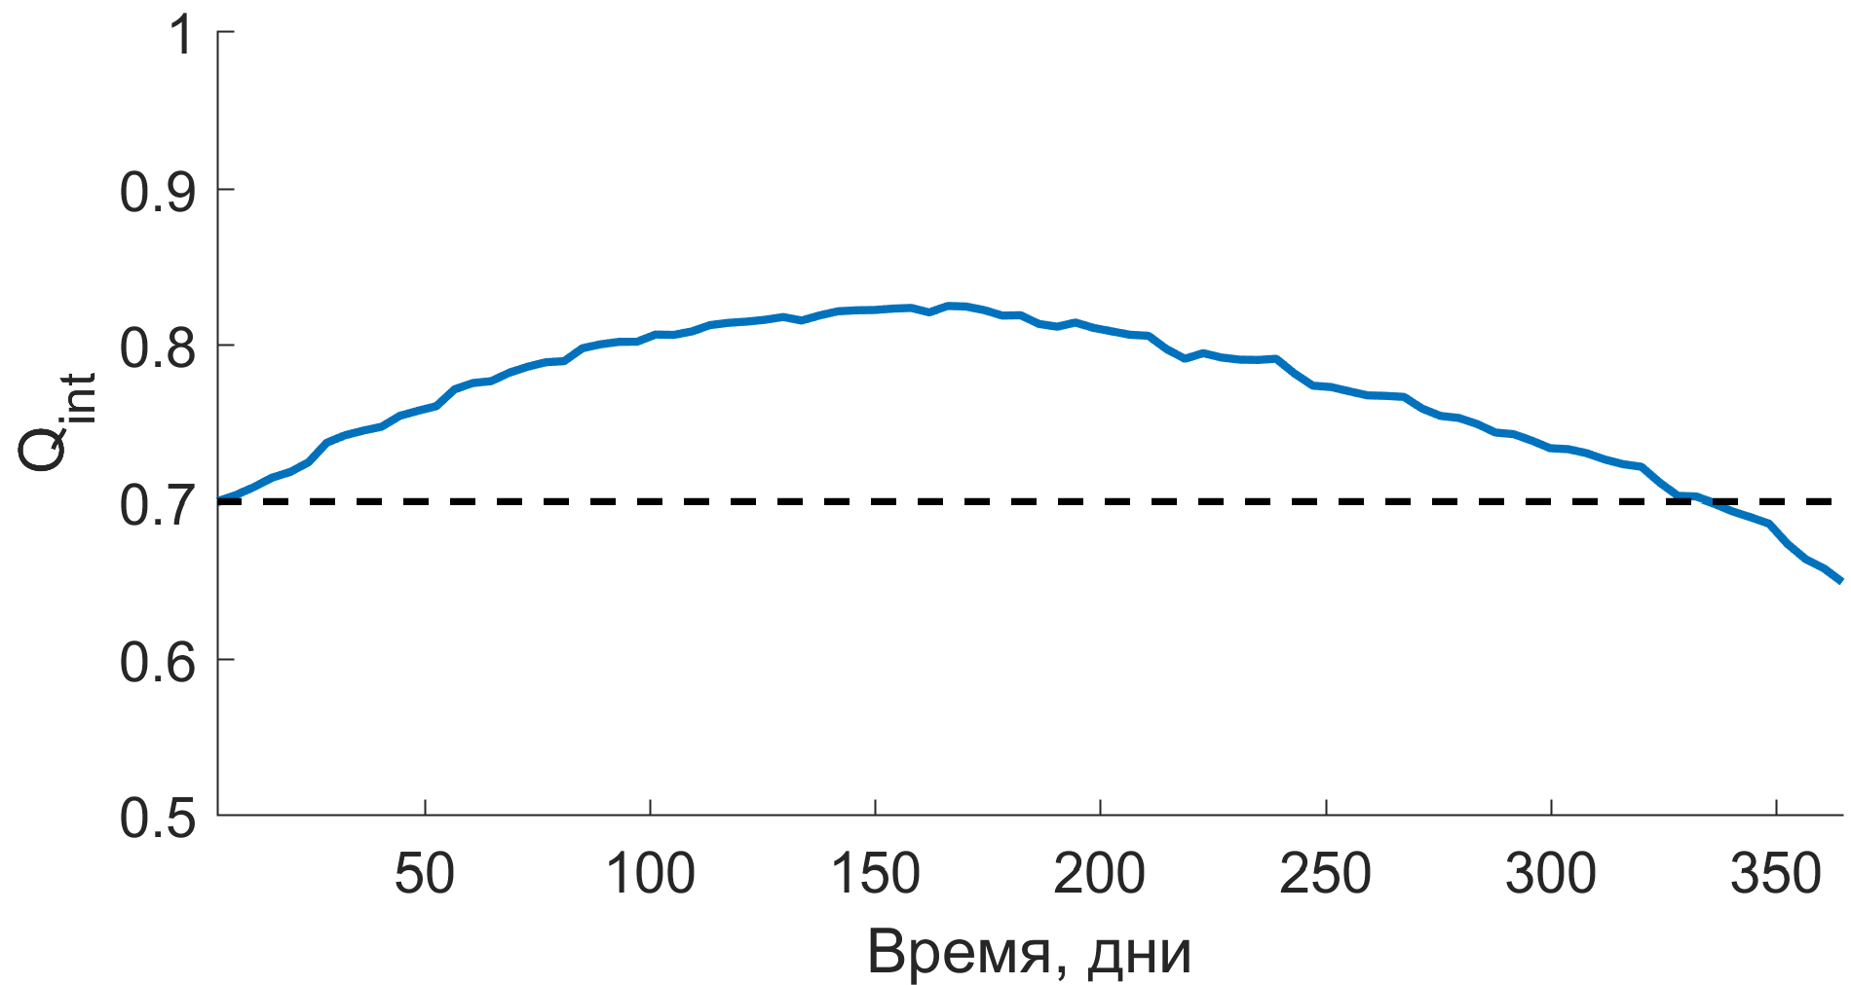
Результаты оптимизации
Изменение для оптимальных орбит
Тетраэдр на 40-м витке
на 83 витках
Notes:
Knowing the best time to initialize the formation and start the mission, we can solve the global optimization problem in the full model. The optimization process took 24 hours on 361 cores to be done. The evolution of formation quality using the orbits obtained after optimization is showed on this figure. 83 revolutions (approximately 340 days) of purely passive motion tetrahedron keeping can be achieved with acceptable quality factor. It should be noted that in previous works we achieved results of no more than 50 revolutions. Such improvement mainly caused by supercomputer optimization and start date analysis. Also animation of tetrahedron evolution in Region of interest at fortieth revolution (where it’s quality is the best) is shown.

Slide 11
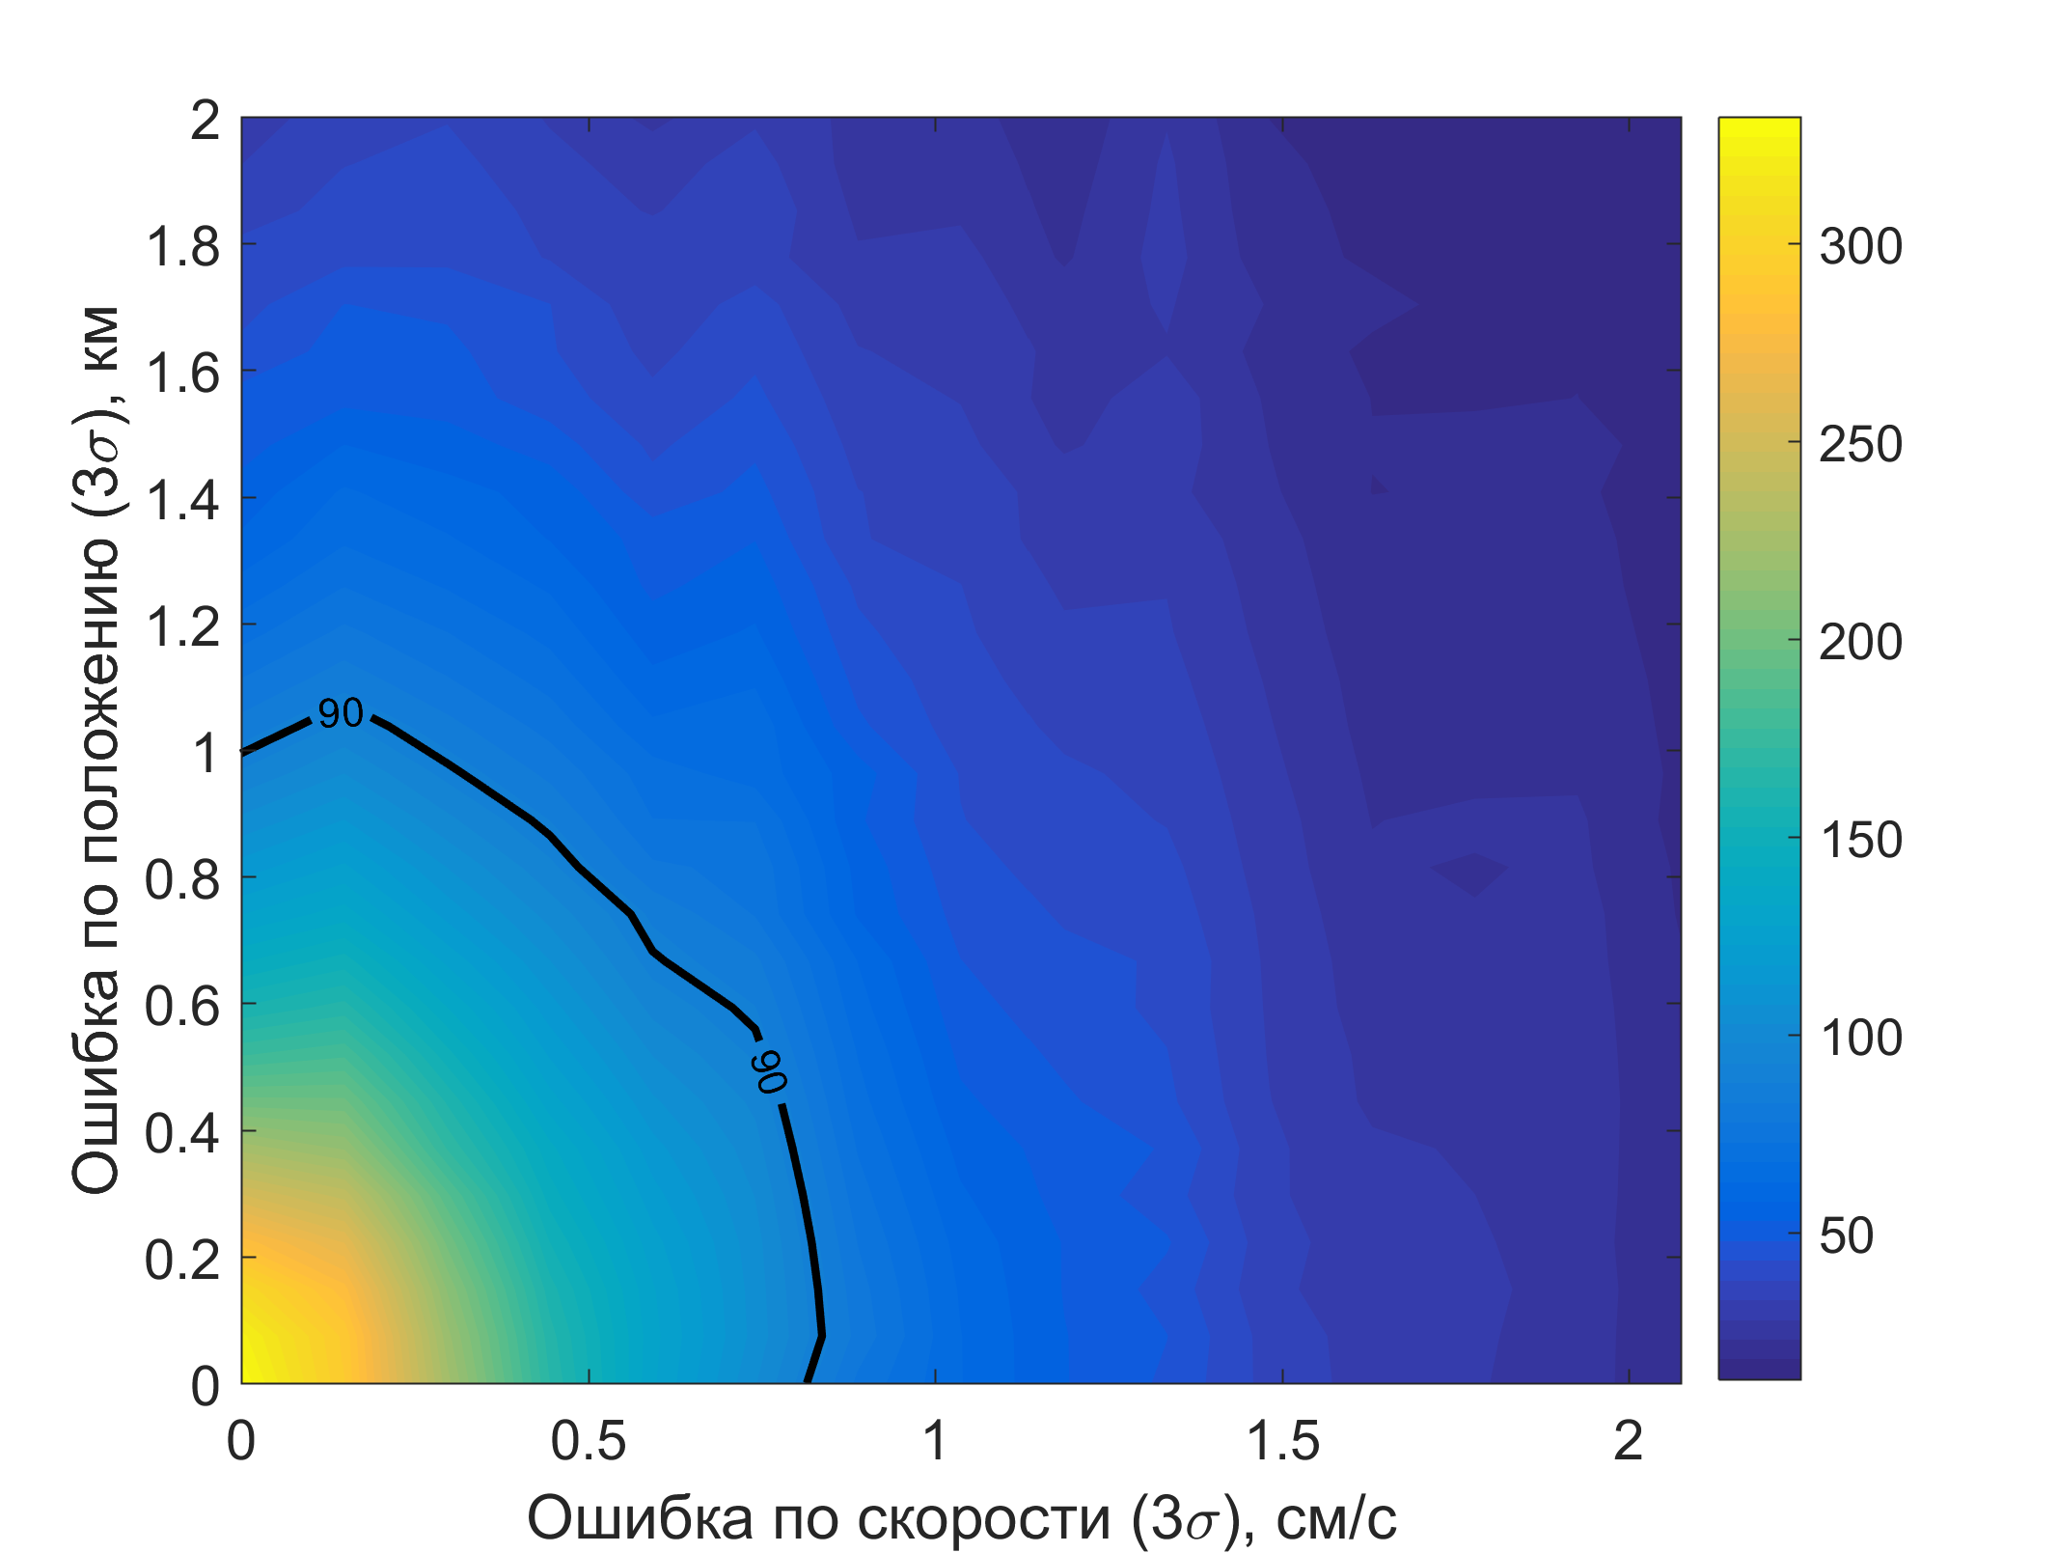
Выведение спутников на орбиту
Длительность миссии (в днях) для различных смещений КА от оптимальных орбит
Срок активного существования миссии зависит от ошибок выведения
Материнский КА (m = 35 кг), несущий дочерние наноспутники, помещается на орбиту ракетой-носителем
Дочерние КА (m = 5 кг) последовательно отделяются от материнского микроспутника
Notes:
Now, let’s proceed to the formation deployment. It is possible to keep the three satellites passive (we will call the deputies), if the chief (other one sat) microsatellite will perform maneuvers and inject Deputies to their optimal orbits. Chief itself had to be placed in its orbit by the launch vehicle.
Nanosatellites are separated from the chief spacecraft by spring pushers. It is also necessary to analyze the impact of deployment errors caused by spring pushers and the Chief’s navigation errors.
To begin with, we computed formation evolution for normally perturbed satellites positions and velocities near the optimal orbits. In the perfect case, mission length is almost a year, but as the satellites get distant from optimal orbits, mission lifetime rapidly decreases. It is clear that the mission lifetime depends heavily on the deployment errors.

Slide 12
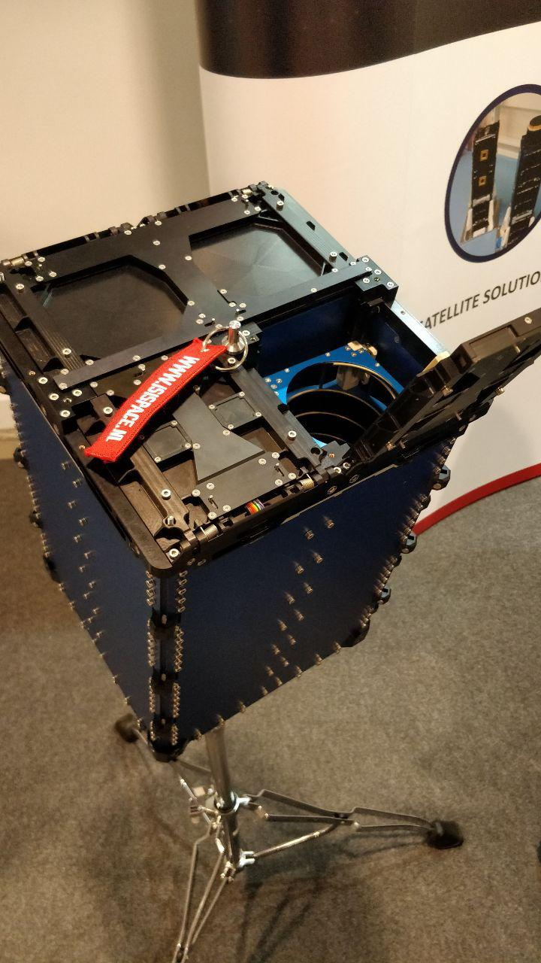
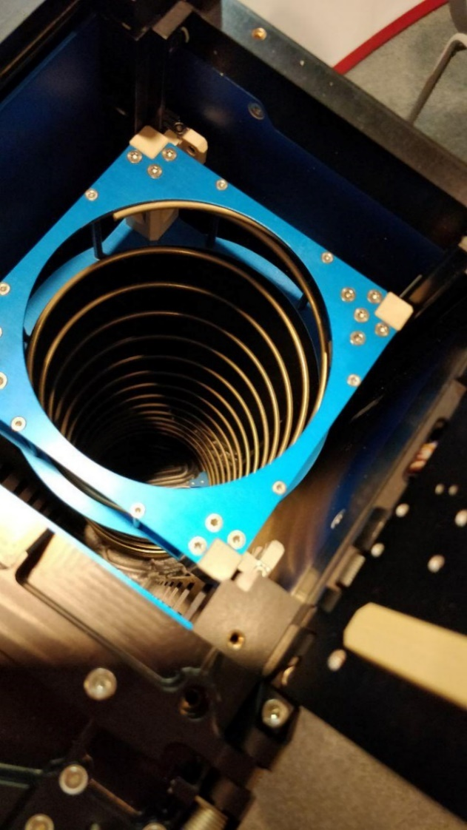
Выведение спутников на орбиту
Срок активного существования миссии зависит от ошибок выведения
Материнский КА (m = 30 кг), несущий дочерние наноспутники, помещается на орбиту ракетой-носителем
Дочерние КА (m = 5 кг) последовательно отделяются от материнского микроспутника
Пружинный толкатель для 3U кубсатов
Notes:
Now, let’s proceed to the formation deployment. It is possible to keep the three satellites passive (we will call the deputies), if the chief (other one sat) microsatellite will perform maneuvers and inject Deputies to their optimal orbits. Chief itself had to be placed in its orbit by the launch vehicle.
Nanosatellites are separated from the chief spacecraft by spring pushers. It is also necessary to analyze the impact of deployment errors caused by spring pushers and the Chief’s navigation errors.
To begin with, we computed formation evolution for normally perturbed satellites positions and velocities near the optimal orbits. In the perfect case, mission length is almost a year, but as the satellites get distant from optimal orbits, mission lifetime rapidly decreases. It is clear that the mission lifetime depends heavily on the deployment errors.

Slide 13
Процесс выведения
Notes:
Here we can see an animation of the deployment found. On the left figure there is a zoomed-in tetrahedron in the barycentric coordinates. On the right there is the position of tetrahedron formation on the highly elliptic orbit and the timeline. Okey, lets start it.

Slide 14
Процесс выведения
Notes:
Here we can see an animation of the deployment found. On the left figure there is a zoomed-in tetrahedron in the barycentric coordinates. On the right there is the position of tetrahedron formation on the highly elliptic orbit and the timeline.
There are separation impulses, which affects both Deputy and Chief, and, between them, correction impulses for the Chief Satellite. Both types of impulses, separation and correction, are located in the apogee region of the given orbit. Here you can see a separation, and, afterwards, the correction of the chief satellite. In time, the tetrahedral formation is deployed at optimal orbits.
Выведение длится 3 орбитальных периода
На каждом витке происходит отделение одного дочернего КА
Материнский микроспутник маневрирует между разделениями
Импульсы отделения не превышают 2 м/c и влияют как на материнский, так и на дочерние КА в зависимости от их массы
Материнский КА вести 30 кг, дочерние – по 5 кг.

Slide 15
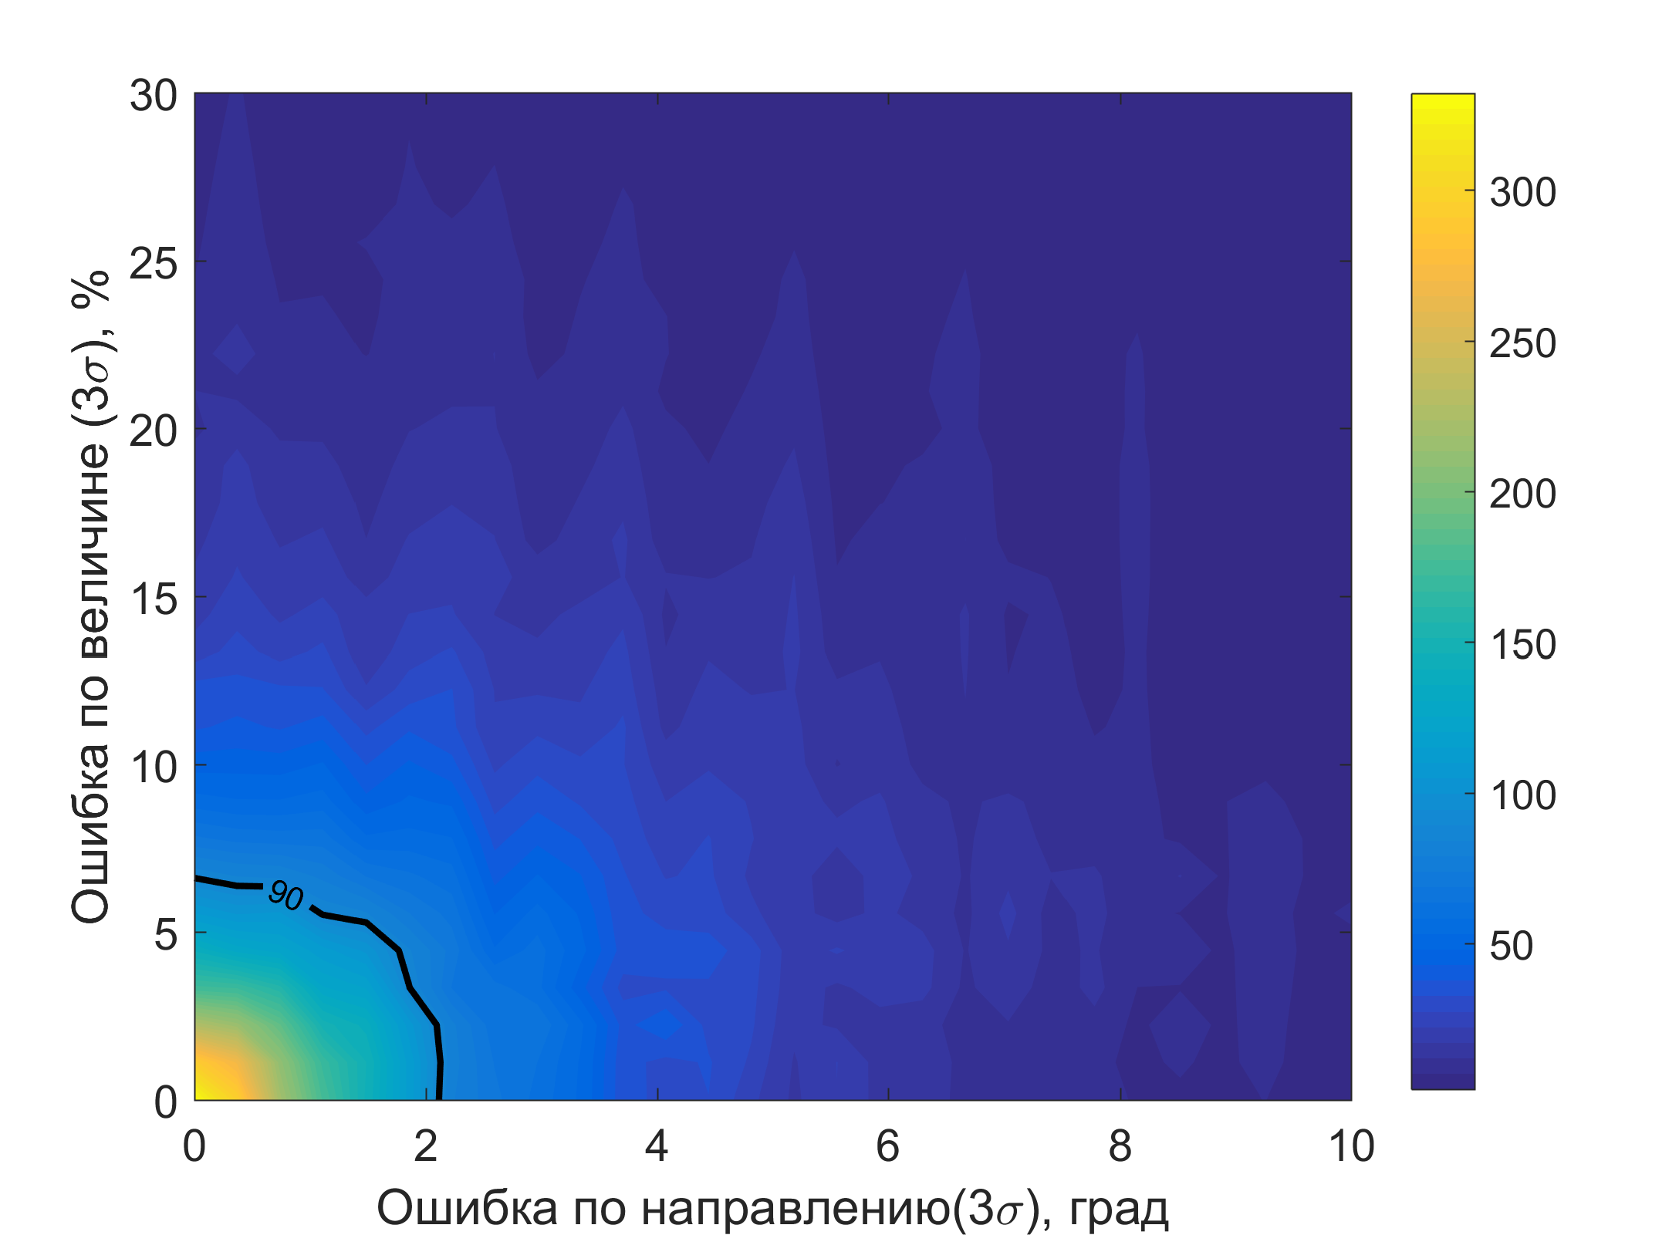
Выведение со стандартными пружинными толкателями
Длительность миссии (в днях) для различных ошибок в пружинном разделении
Найденные импульсы разделения имеют величину до 2 м/c
Использование пружинных толкателей влечет ошибки до 30% по величине импульса
Типичные ошибки пружинных толкателей – 20 % по величине и 5 градусов по направлению – приводят к разрушению формации менее чем на месяц
Notes:
Separation impulses found have magnitude from up to 2 m/s. It is known that spring pushers are the source of large errors, up to 30% of impulse magnitude
Assuming that the chief spacecraft control between separations is accurate, we estimated mission lifetime dependency on separation impulse errors. The corresponding results are depicted at the screen. Despite the precise positioning of the chief satellite, typical errors in spring pusher impulses cause a formation to degrade in a few months. Therefore, we should consider a more precise deployment method.

Slide 16
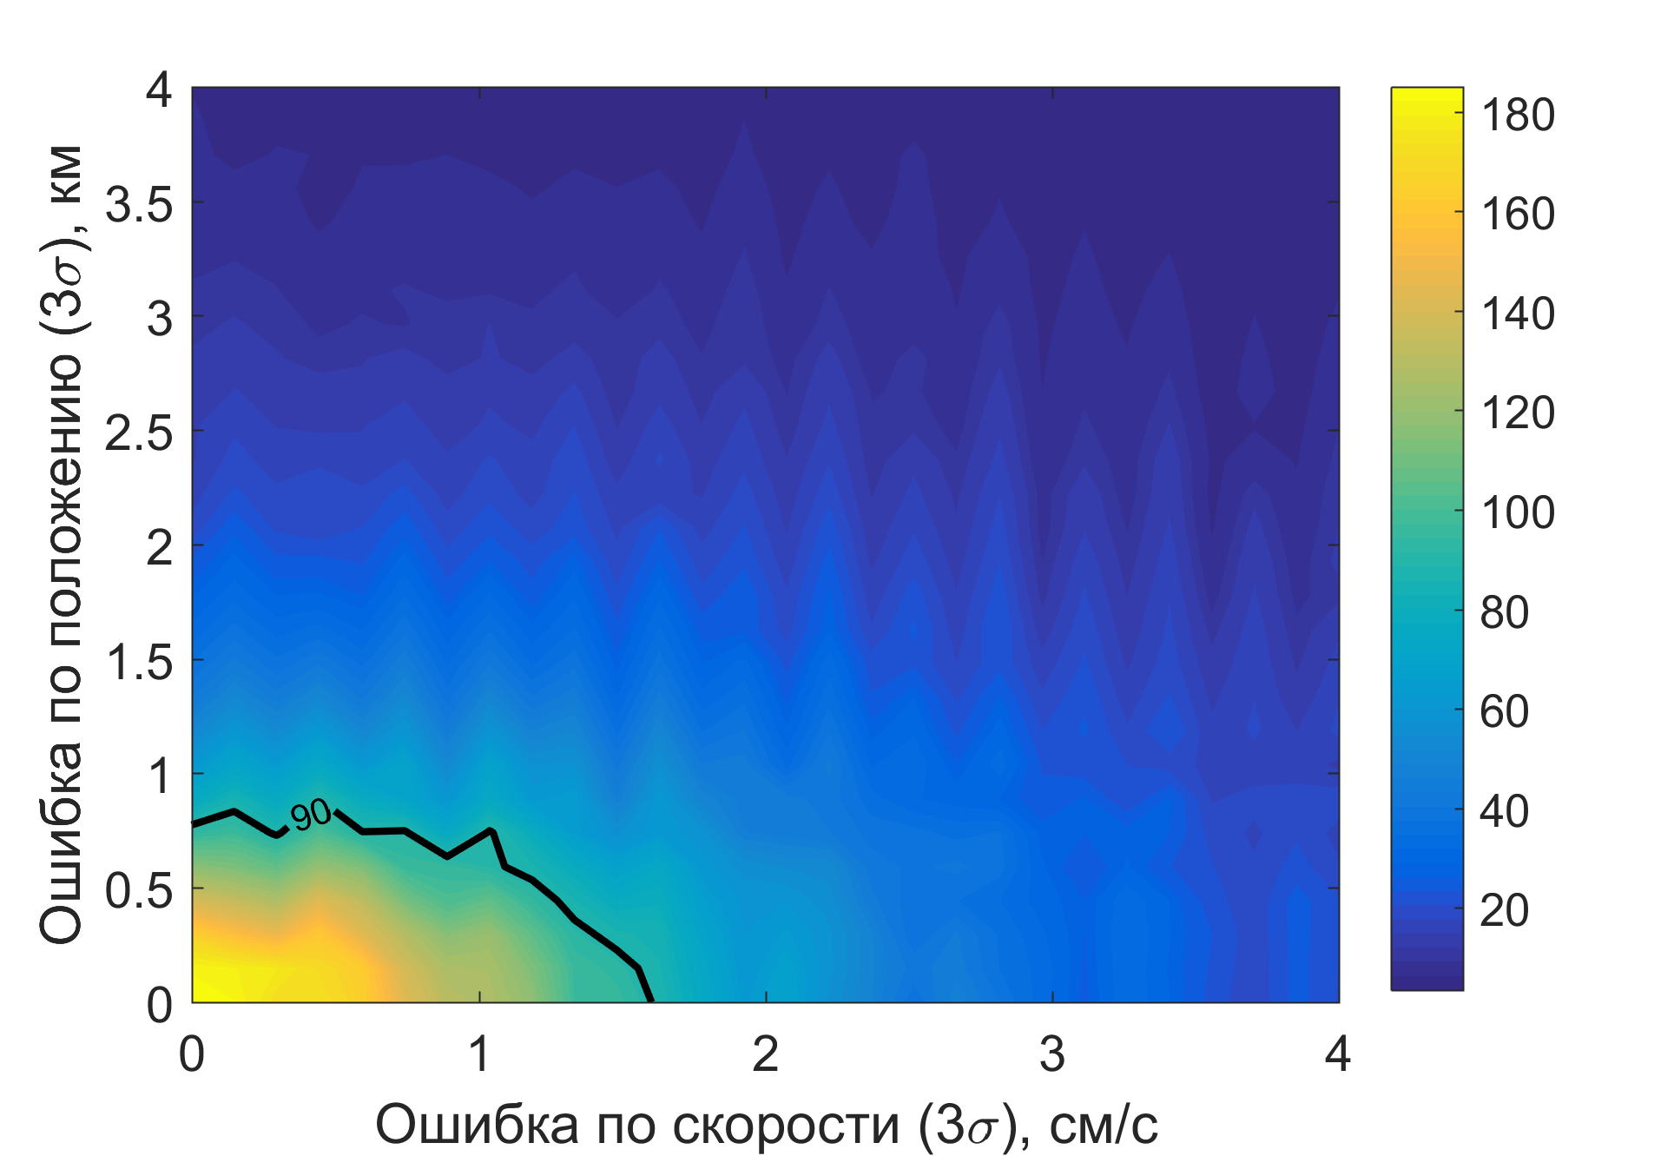
Выведение с низкоскоростным отделением
Длительность миссии (в днях) для различных навигационных ошибок материнского КА
Для увеличения срока активного существования миссии предлагается использовать низкоскоростное отделение (<5 см/c)
Ошибки импульсов отделения дочерних КА зафиксированы как 20% и 5 градусов
Для поддержания формации в течение трех месяцев требуется управление материнским КА с точностью 0.8 км и 1.6 см/c
Notes:
In the recent document, published by ESA, the low-velocity orbital deployer (LV-POD) is mentioned. Yesterday, I also had a confirmation from some companies that such deployers are being developed. It should be able to separate CubeSats with relative velocities of 5 cm/s. That can reduce the impact of errors on the mission lifetime.
We can now determine the necessary navigation accuracy level for the chief satellite. The sigma interval for separation impulses errors was fixed as 20% in magnitude and 10 deg in direction, as mentioned in the corresponding document. The map of position and velocity errors for the chief satellite navigation is presented in Figure. To maintain mission for three months, chief accuracy as of 0.8 km in position and 1.6 cm/s in speed is required. Such navigation accuracy is achievable by modern propulsion systems.

Slide 17
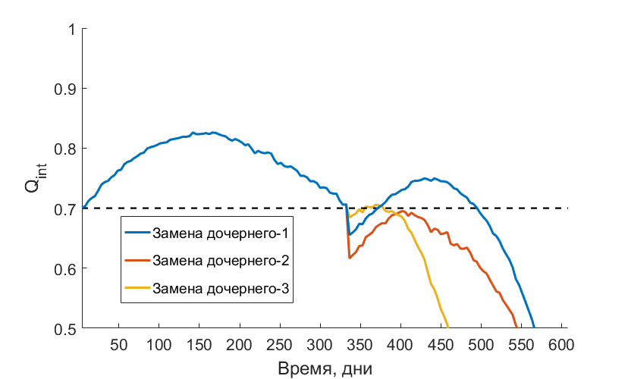
Продление миссии
Материнский КА приводится на новую орбиту при помощи управления, м/с
Один из дочерних КА заменяется дополнительным наноспутником
Возможно продление миссии на 31 виток (всего 114 витков, 460 дней)
Изменение для продленной миссии
на 114 витках
Notes:
The main conclusions from this work are as following.
It is possible to find orbits for four satellites such that formation will keep acceptable tetrahedral shape for almost a year of purely passive motion
Corresponding optimization problem can be solved efficiently by means of supercomputer
The errors caused by standard spring pushers lead to quick formation degradation in less than 30 days. To keep the tetrahedron in required shape for at least three months, it is needed to utilize low-velocity deployer, and to be able to control chief sat with precision of 0.8km at position and 1.6 cm/s at speed.

Slide 18
Заключение
Доказана возможность развертывания на высокоэллиптической орбите тетраэдральной формации, сохраняющей благоприятную геометрию в течение почти года пассивного полета
Предложен способ способ выведения формации на орбиту, определены требования к точности навигации материнского КА
Приобретены навыки:
моделирования орбитального движения КА
решения вычислительно сложных оптимизационных задач
анализа и визуализации полученных результатов
подготовки научных публикаций и выступления с докладами

Slide 19
Список публикаций и конференций по теме работы
Michael D. Koptev, Sergey P. Trofimov, Mikhail Yu. Ovchinnikov. Design and Deployment of a Nanosatellite Based Tetrahedral Formation// Journal of Guidance, Control, and Dynamics, 2017 (в процессе подготовки)
M. Koptev, S. Trofimov. Improved Design and Deployment Analysis for a HEO Tetrahedral Formation with Passive Deputy Nanosatellites // Small Satellites Systems and Services (4S) Symposium, 28 May-1 June 2018, Sorrento, Italy
Коптев М.Д., Трофимов С.П. Проектирование, развертывание и поддержание тетраэдральной формации наноспутников на высокоэллиптических орбитах // Препринты ИПМ им. М.В.Келдыша. 2018. № 97. 28 с.
M. Koptev, Y. Mashtakov, M. Ovchinnikov, S. Shestakov. Novel Approach to Construction and Maintenance of Tetrahedral Formation// Proceedings of 9th International Workshop on Satellite Constellations and Formation Flying, 20-22 June 2017, Boulder, Colorado, United States, Paper IWSCFF 17-29, 18p.
Коптев М.Д., Трофимов С.П. Проектирование, развертывание и поддержание тетраэдральной формации наноспутников на высокоэллиптических орбитах // Второй Российский симпозиум по наноспутникам с международным участием 28-30 июня 2017 года, Самара, Россия
M. Koptev, S. Trofimov, S. Shestakov, Y. Mashtakov. Design and Keeping of Nanosatellite-Based Highly Elliptical Orbit Formation // Paper DyCoSS3-039, 3rd IAA Conference on Dynamics and Control of Space Systems, Moscow, Russia, May 30-June 1, 2017, 13 p.
С.А. Шестаков, М.Д. Коптев. Построение управления для поддержания тетраэдральной конфигурации спутников // XLI Академические чтения по космонавтике, 24-27 января 2017 года, Москва, Россия

Slide 20
Спасибо за внимание!

Slide 21
Дополнительные слайды

Slide 22
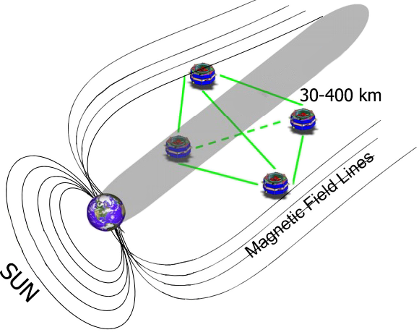
Предпосылки
Распространение малых КА
Миссия NASA Magnetospheric Multiscale (MMS)
Тетраэдральная формация на высокоэллиптических орбитах
Маневрирование КА для компенсации дрейфа
Спутники MMS весили 1360 кг
Credit: NASA's Goddard Space Flight Center
Notes:
Over the last decades the role of small spacecraft has significantly increased. It is now possible to utilize small-sized satellites in all kinds of missions.
One example for such mission is Earth magnetospheric study, such as the recent NASA Magnitospheric Multiscale mission, which studied specific regions of earth’s magnetosphere tail.
In MMS Mission, four full-sized satellites were keeping tetrahedron formation to provide necessary measurements.
Each sat weighted more than 1000 kg (one thousand kilos) to be able to execute maneuvers and prevent formation degradation. In this work we will also consider tetrahedron formation keeping in selected regions of highly-elliptic orbit, but using nanosatellites. That means that we will concentrate mainly on the passive motion and orbits optimization.

Slide 23
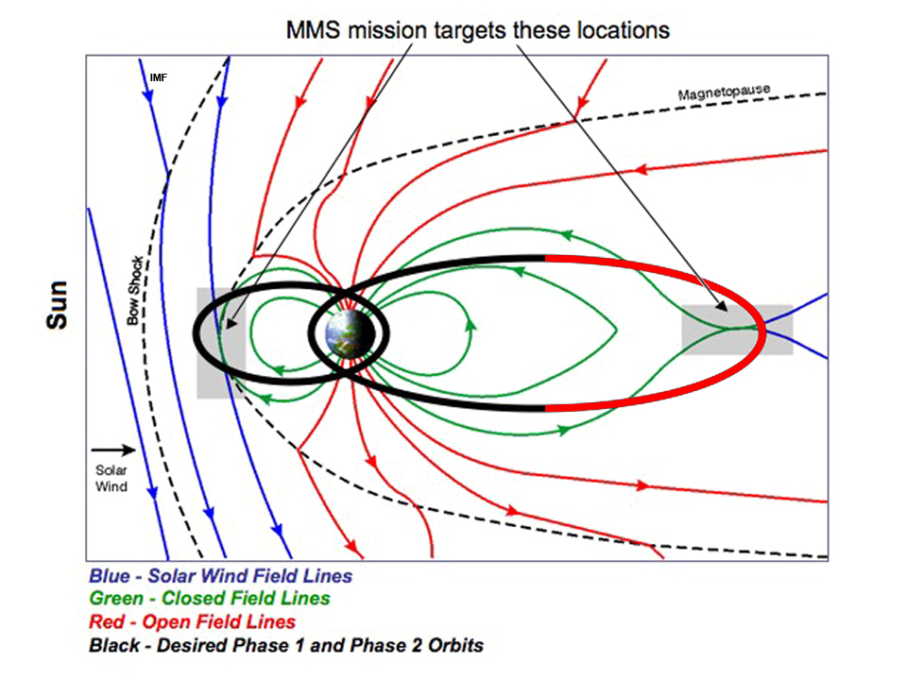
Опорная орбита
Высокоэллиптическая орбита
, старт с Байконура
Область интереса:
Возмущения: J2, Луна, Солнце
Credit: NASA's Goddard Space Flight Center
Notes:
The highly elliptical reference orbit was chosen to be similar with the one used in the second phase of MMS mission. The apogee distance was set to two hundred thousand kilometers, and the perigee is two thousand kilometers.
Inclination is fifty one-point-six degrees, assuming the mission start from Baikonur.
The longitude of the ascending node was set to zero to minimize the angle between orbital plane and the Plane of Ecliptic.
Periapsis was also set to zero, which means that the orbit apogee is placed in the center of magnetotail on the vernal equinox day.
As we intend to make measurements in the magnetotail, we will only try to keep formation in the remote region of interest (red on the picture). It consists of points, distanced from the Earth for more than 15 Earth radii (approx. 95 thousand kilometers).
Non-sphericity of Earth and perturbations due to the Moon and the Sun are considered in orbits propagations, as those perturbations have great influence on formation quality.

Slide 24
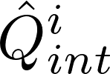
Оптимизационная задача
Необходимо оптимизировать орбиты четырех КА в окрестности опорной орбиты
Оптимизируемый функционал:
Неизвестный вектор : 6 параметров орбиты для каждого из четырех КА (всего 24 параметра)
– число орбитальных периодов
– функционал качества формации на i-м витке
Notes:
Now I will describe optimization process. The goal is to optimize the orbits of four satellites in the vicinity of the reference orbit.
We will maximize the following function, which basically means the mean value of integral formation quality factor on a number of revolutions.
The unknown 24-dimensional vector x stands for the differential orbital elements for four spacecraft, six elements for each.
This (point to qint) is basically the integral formation quality on the i-th revolution. To calculate it, we have to propagate the motion of the four satellites on a given orbits.
As we want to keep formation in good shape for as much as possible, we have to maximize the Nrev, which stands for the number of revolutions. But it cant be set very high due to computation time costs. In this work, we set it equal to 100 (one hundred) revolutions.
Minor modifications were done for better optimization, and it can be thought as regular integral formation quality factor on i-th revolution. Additional details on modification can be provided later at request. They are also can be found in conference paper.

Slide 25
Оптимизация на суперкомпьютере
Применяется островная модель из библиотеки C++ pagmo
Библиотека разработана ESA для решения оптимизационных задач параллельно
Различные оптимизационные алгоритмы работают на различных «островах» (т.е. CPU)
Острова обмениваются информацией о лучших кандидатах в процессе оптимизации
Использование суперкомпьютера К-60 позволило увеличить число островов до 361
Расположение островов в оптимизационном процессе
Notes:
As the optimization problem is massive, and the computation of the objective function takes lot of time due to numerical integration, we decided to use supercomputer to solve it in a parallel way. The C++ library pagmo, which was developed by ESA, was used. Pagmo library is a parallel implementation of generalized island model. In this model different optimization algorithms work in separate threads, while asynchronously exchanging information about best candidates to speed-up computations and improve results. The topology of islands dictating possible ways for migration of the solutions can also be set. Supercomputer k-60, located in Keldysh institute of applied mathematics, allowed to use 361 (three-hundred-and-sixty-one) core for optimization.

Slide 26
Оптимизация на суперкомпьютере
Для выбора алгоритмов оптимизации была использована тестовая задача
Алгоритмы на внешнем кольце:
- Дифференциальная эволюция (DE)
- Эволюционная стратегия с адаптацией ковариационной матрицы (CMAES)
- Метод роя частиц (PSO)
- Квадратичное программирование (SQP)
Центральный остров:
- Метод Subplex
Расположение островов в оптимизационном процессе
Notes:
To select the most appropriate algorithms from the wide list available in pagmo, the benchmark was developed. It consists of maximizing the same objective function, but on a single orbital period and without perturbations. That benchmark allowed us to test every algorithm from pagmo in a short period of time. After the test, the following global optimization algorithms have been selected: Differential Evolution (DE), Covariance Matrix Adaptation Evolution Strategy (CMAES), Particle Swarm Optimization (PSO), and Sequential Quadratic Programming (SQP). They were spawned in the bidirectional ring topology, so that islands may exchange information with the closest ones.
Also we connected them all with a central island, where the local optimization subplex algorithm refined best results from the outer ring and injected them back.

Slide 27
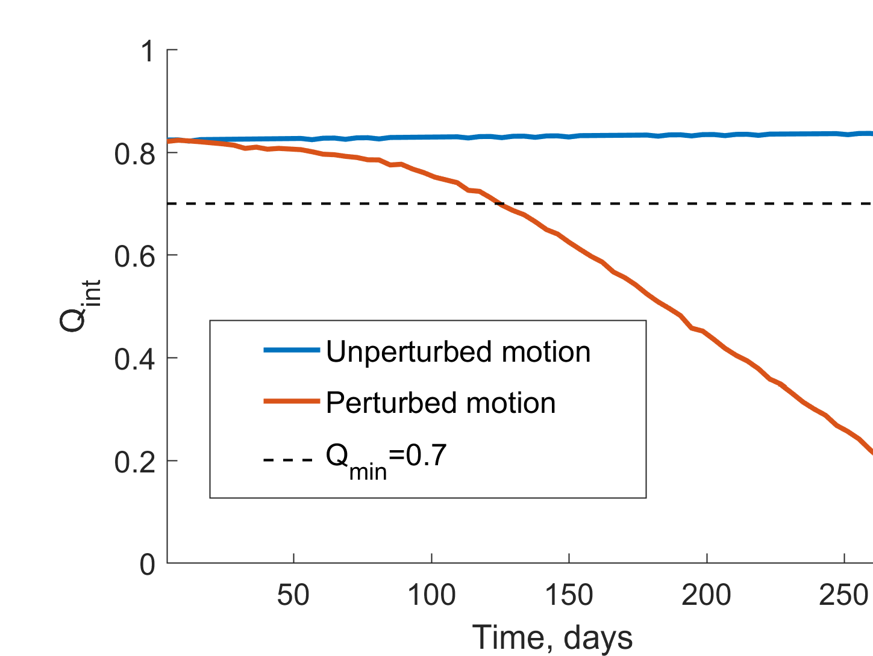
Анализ выбора даты старта (1)
Срок активного существования может сильно зависеть от даты старта миссии
Одинаковые орбиты нужно рассмотреть со стартом в различные дни
Для получения таких орбит была проведена оптимизация в задаче двух тел
Notes:
There is one more detail to be considered prior to optimization.
As you can see in the figure, the tetrahedral formation will slowly degrade over time due to the second harmonics and lunisolar perturbations. The latter are time-dependent and determined by celestial bodies positions. Therefore, overall mission lifetime may depend heavily on the mission start date.
To find the optimal date to launch the mission, we conducted a numerical experiment in which the same initial orbits were propagated starting at different days. To obtain those orbits, we optimized objective function in the unperturbed two-body model. Optimization was accomplished according to the scheme described previously.
The evolution of formation quality factor can be seen here, with noticeable formation degradation in perturbed motion model. We also noticed that at the initial moment of time the quality exceeds 0.7; therefore, we also propagated theequations of satellite motion backwards.

Slide 28
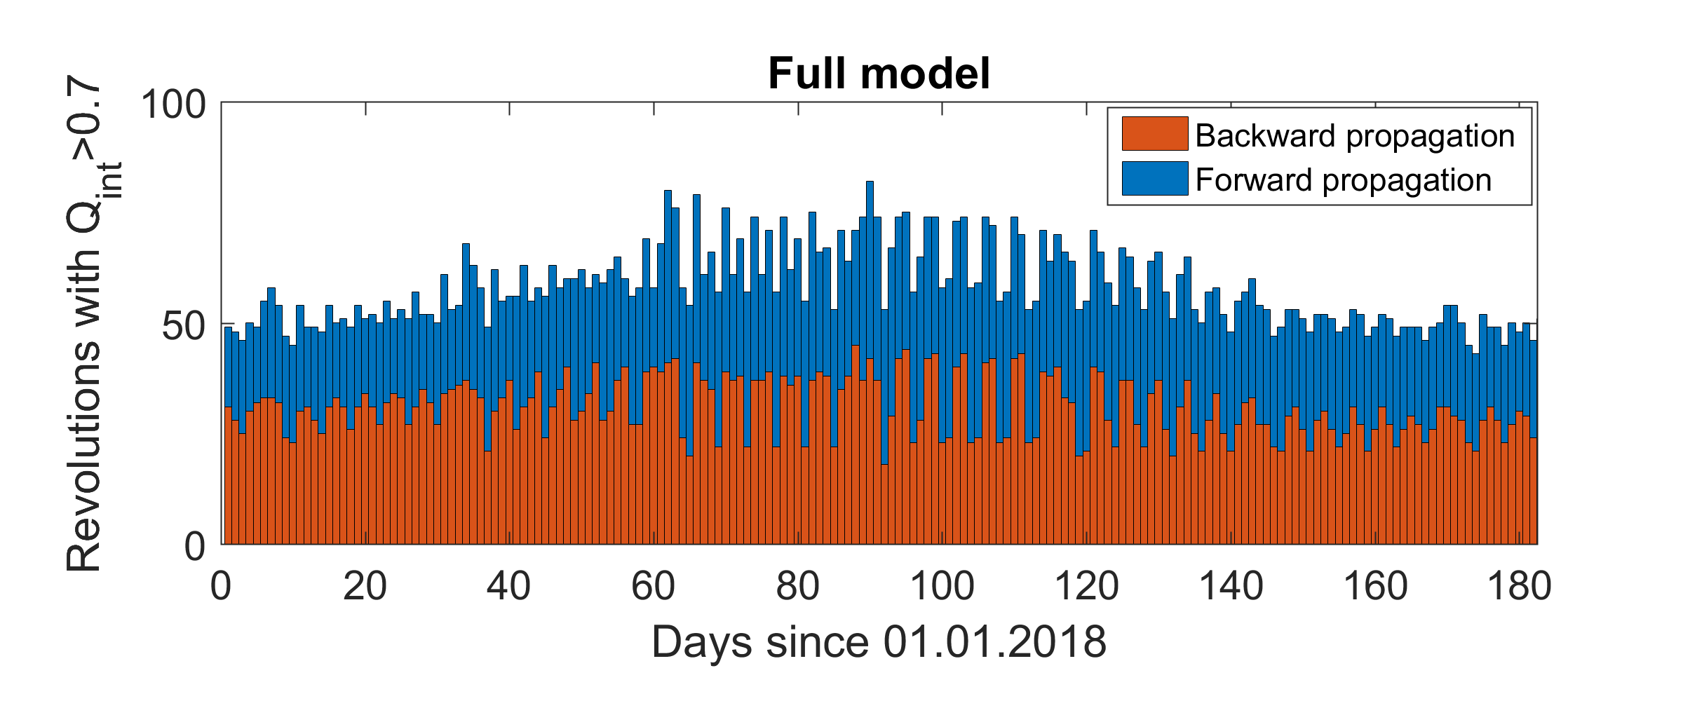
Анализ выбора даты старта (2)
Notes:
At this histogram each bar represents certain day chosen to be initial for back and forward propagations of the same orbits. It is seen that overall mission lifetime varies from 45 to 80 revolutions ( which is 180 to 320 days, 1 revolution is approx. 4 days). Almost twice the difference using the same orbits but with different start dates.
The short-period oscillations in mission lifetime are caused by the Moon, let’s consider the no-Moon (with only J2+Sun perturbations taken into account) case to smooth out the picture.

Slide 29
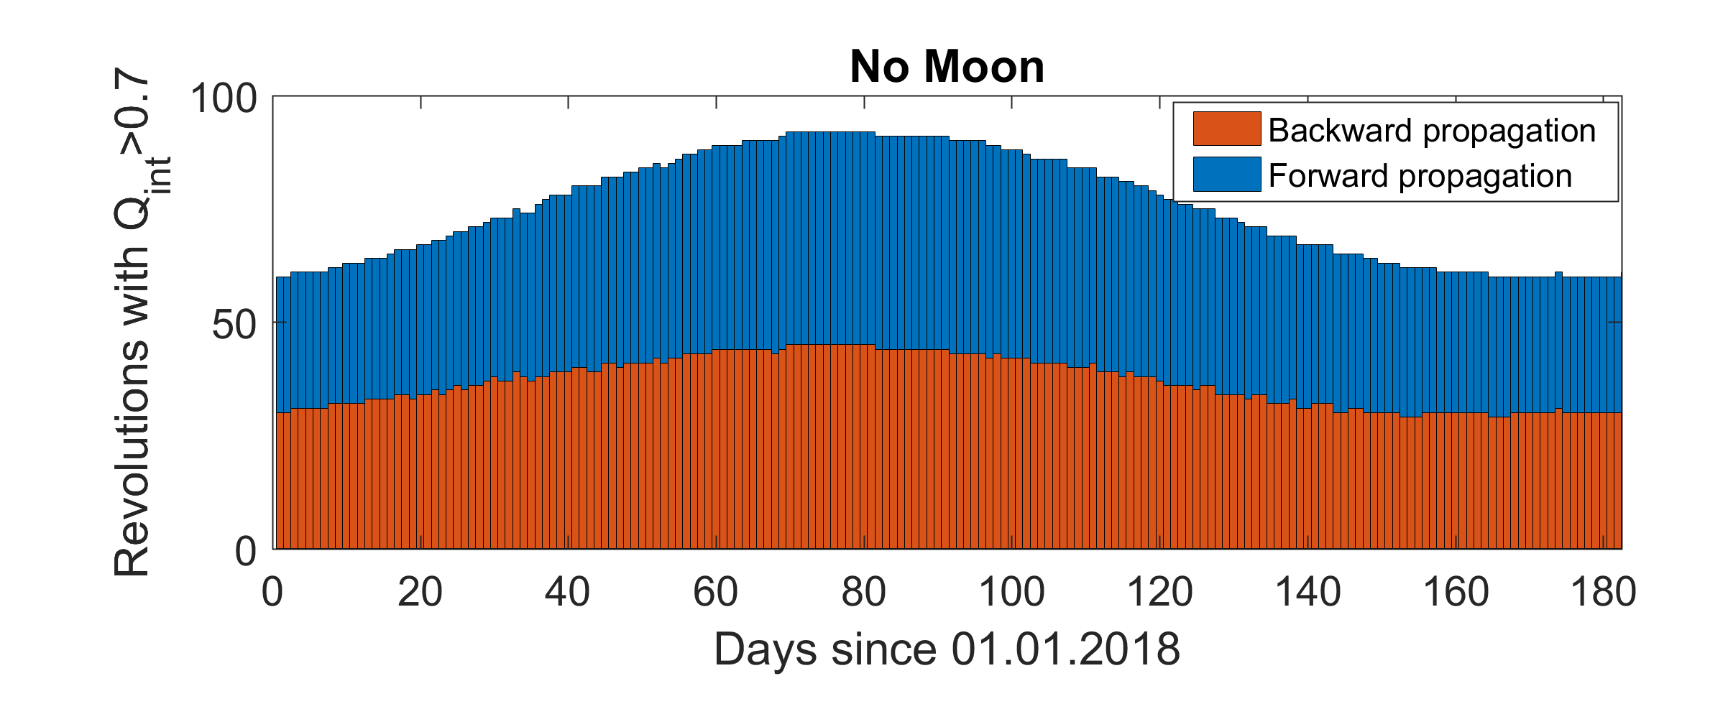
Анализ выбора даты старта (3)
Notes:
Here we did the same, but “disabled” moon perturbations. It is clearly seen that in Spring perturbations by the Sun are least destructible to formation quality. Naturally, at this time the orbit apogee is most distant from the Sun. Also, at vernal equinox the reference orbit apogee is in the middle of Earth magnetosphere tail, where it is needed to obtain required measurements. We will further consider that mission start date is chosen 45 days prior to vernal equinox, to ensure the orbit apogee will be placed in magnetotail in the first few months of the mission.

Slide 30
Выведение со стандартными пружинными толкателями
Выведение длится 3 орбитальных периода
На каждом витке происходит отделение одного дочернего КА
Материнский микроспутник маневрирует между разделениями
Импульсы отделения не превышают 2 м/c и влияют как на материнский, так и на дочерние КА в зависимости от их массы
Материнский КА вести 30 кг, дочерние – по 5 кг.
Notes:
We assumed that the deployment should happen within the three revolutions prior to mission start, each revolution being reserved for the separation of single satellite. The chief satellite, originally placed in orbit to be found, corrects its orbit between the separations. As a result of undocking the nanosatellites, the mass of the chief satellite gradually decreases, which should also be considered in simulations. The separation impulse affects both Deputy and the Chief.

Slide 31
Выведение со стандартными пружинными толкателями
Оптимизационная задача с 30 неизвестными:
шесть элементов для начальной орбиты материнского КА
три импульса коррекции положения материнского КА
три импульса разделения
каждый импульс описывается тремя компонентами и временем исполнения
Notes:
There are 30 unknown variables in the deployment process. Six stand for initial orbit of the chief spacecraft, and 24 are distributed between six impulses of deputy separation and the chief correction. Each impulse is described by its execution time and the three components.
To find deployment scheme, impulses and orbits, the sequential quadratic programming method has been used. Correction impulses magnitude were minimized during the optimization process.

