Slide 1
Study of Attitude Determination Accuracy and Earth-point Stabilization Performance Using Asynchronous Star Tracker and Angular Velocity Sensor Measurements
Danil Ivanov, Uliana Monakhova, Yaroslav Mashtakov
Keldysh Institute of Applied Mathematics RAS
16 October 2024

Slide 2
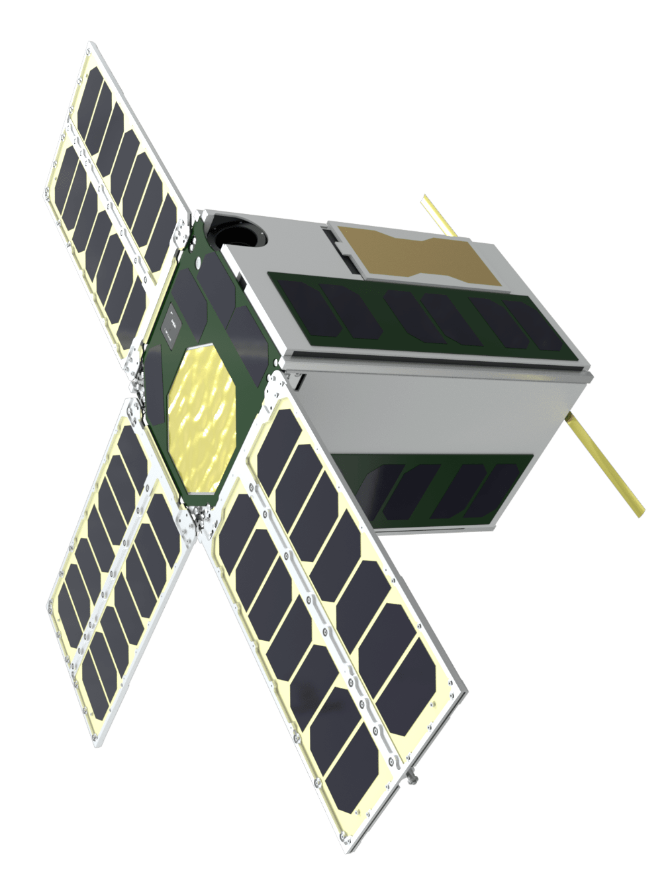
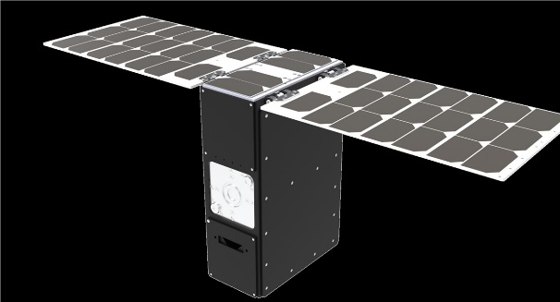
Introduction
High resolution Earth observation missions and optical laser communications require precise attitude control performance
During camera or laser stabilization to on-Earth point of interest satellite attitude must track complex trajectory profile
Attitude motion determination in real-time is the most critical issue
Star tracker and angular velocity sensor measurements are often used in ADCS
Camera
optical
axis
Laser communication beam
2

Slide 3
Problem statement
Considered:
Satellite is in LEO, satellite-fixed axis tracks Earth point
ADCS includes reaction wheels, star tracker and angular velocity sensor
Time moments of the control calculation, star tracker measurements and angular velocity measurements are asynchronous
Star tracker measurements are available with a delay
Under high angular velocity star tracker measurements are not available
Goals of this study:
Develop EKF-based attitude determination algorithms
Estimate Earth-point stabilization performance
Delayed measurements
Star
tracker
Attitude control algorithm
3

Slide 4
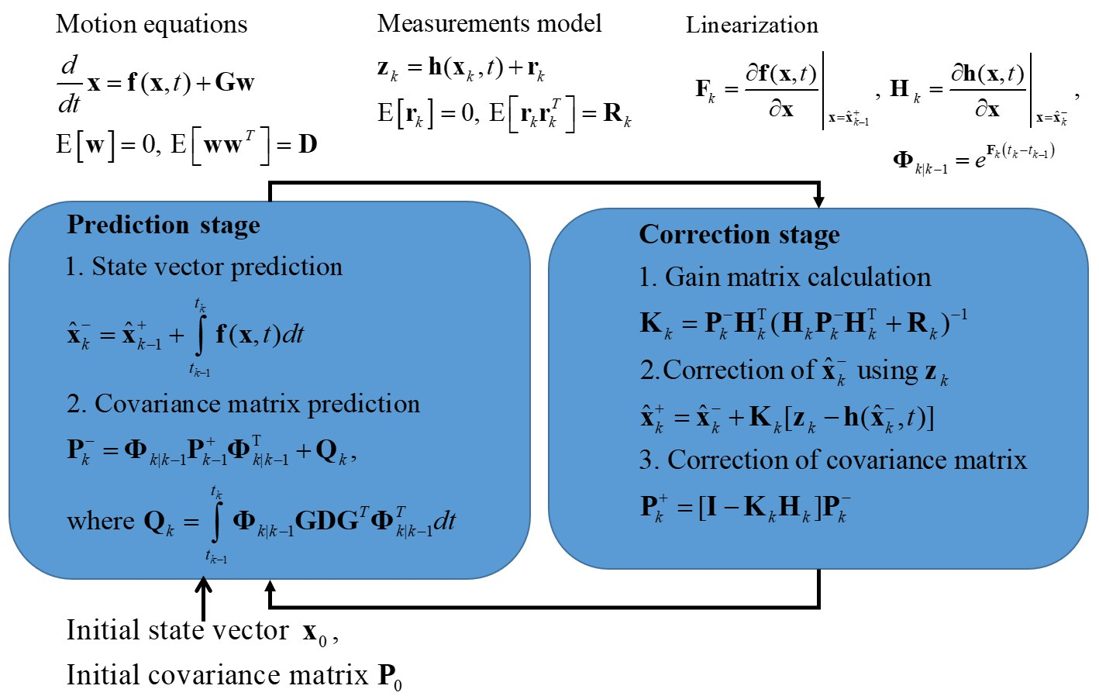
Extended Kalman filter
4

Slide 5
Motion equations and its linearization
Kinematic equations in quaternions
Results of linearization
Euler equations
5

Slide 6
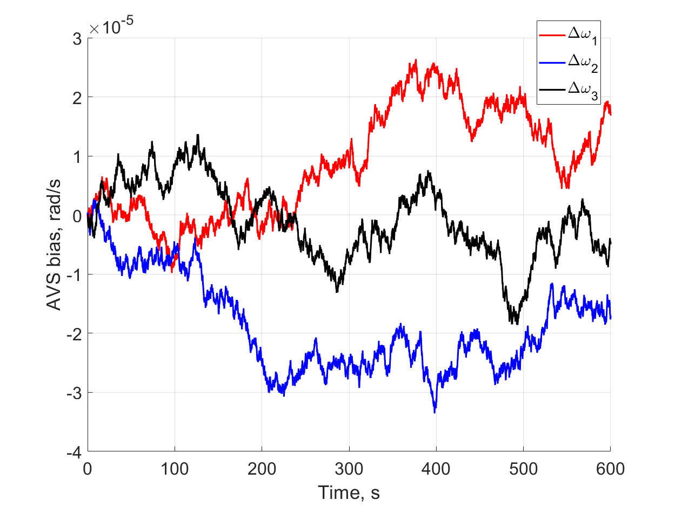
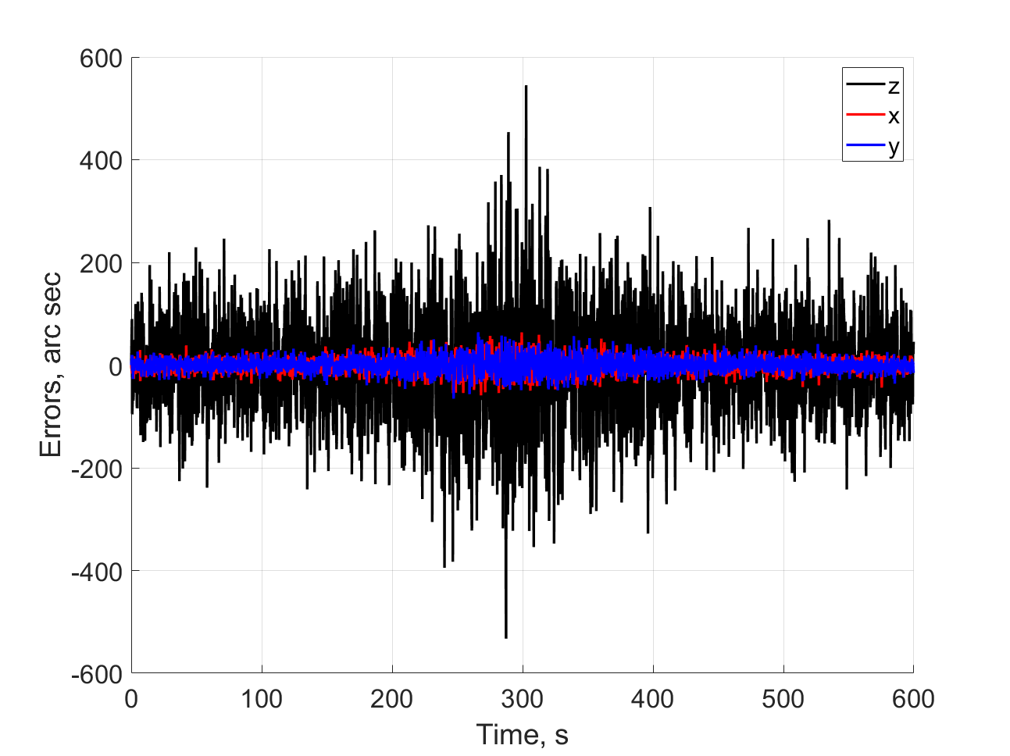
Measurement models
AVS bias example
Angular velocity sensor measurement model
Star tracker measurement model
Star tracker measurements errors
6

Slide 7
Kinematic and dynamic EKF
Kinematic EKF:
System matrix:
System noise influence matrix:
Measurement matrix:
State vector:
Diagram of time moments
Dynamic EKF:
System matrix:
System noise influence matrix:
Measurement matrices:
State vector:
Diagram of time moments
7

Slide 8
Reference motion for Earth-point tracking and control
.
For Earth-point tracking the reference attitude motion is calculated using the following data:
– optical camera axis coincides with satellite axis
– optical axis of a star tracker is in the plane
Reference frame axis are
Reference frame angular velocity:
Reference angular acceleration:
Lyapunov-based control:
where:
where:
8

Slide 9
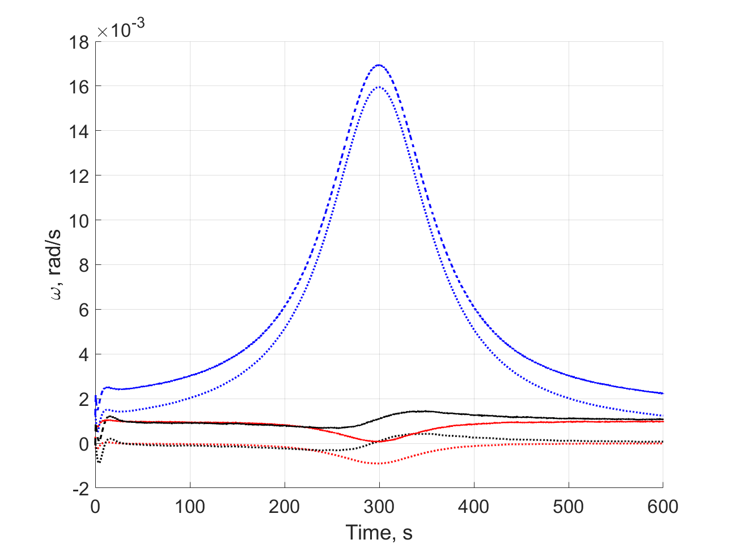
Numerical study parameters
Angular velocity and angular velocity sensor measurements with bias
Parameter | Value
Orbit height, km | 500
Orbit inclination, deg | 97,38
Standard deviation of star tracker measurements at zero angular velocity, arc sec
Standard deviation of star tracker measurements at angular velocity 1 deg/s, arc sec
Constant star tracker delay, s
Time-stamp noise std, s
Standard deviation of angular velocity measurements, deg/s
Standard deviation of derivative of angular velocity measurements, deg/ s²
Angular velocity measurements delay, s
Inertia tensor, kg*m²
Star tracker measurements frequency, Hz | 5
Angular velocity sensor measurements frequency, Hz | 50
Control calculation frequency, Hz | 50
System noise covariance matrix for kinematic EKF:
System noise covariance matrix for dynamic EKF:
Star tracker measurements error
9

Slide 10
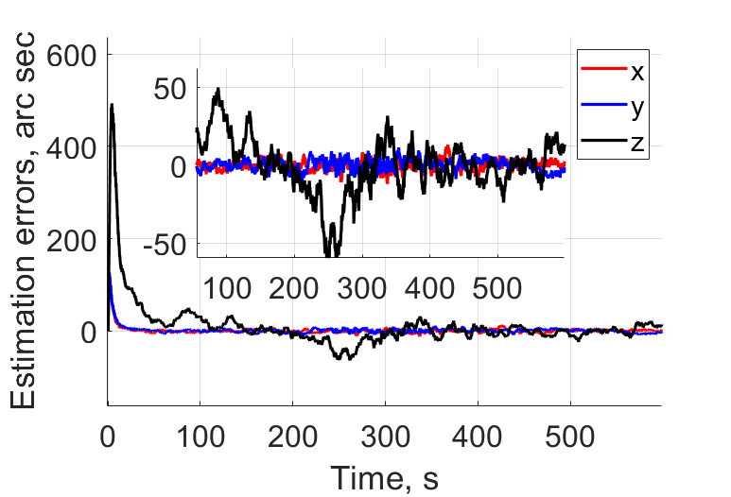
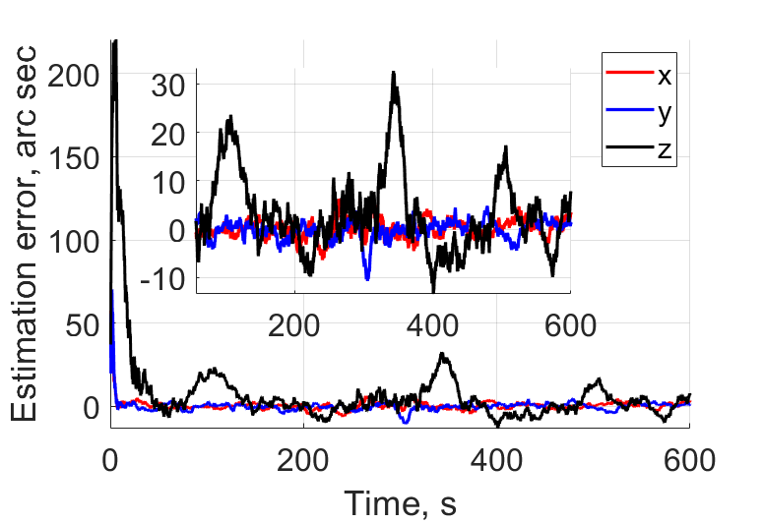
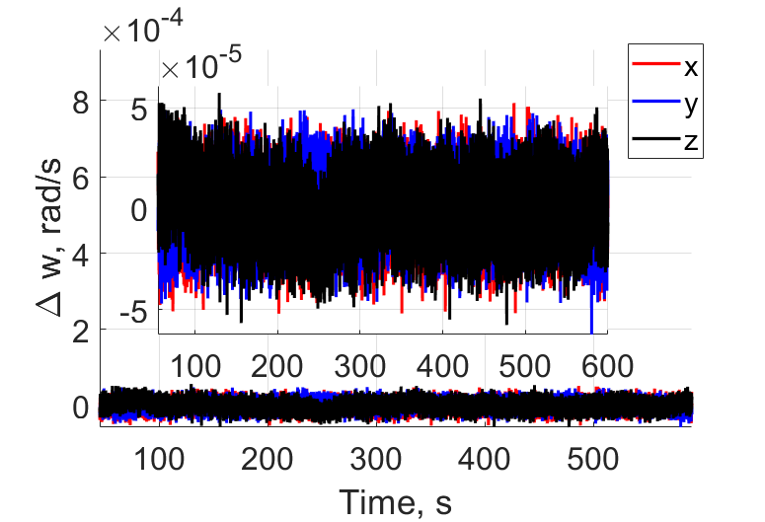
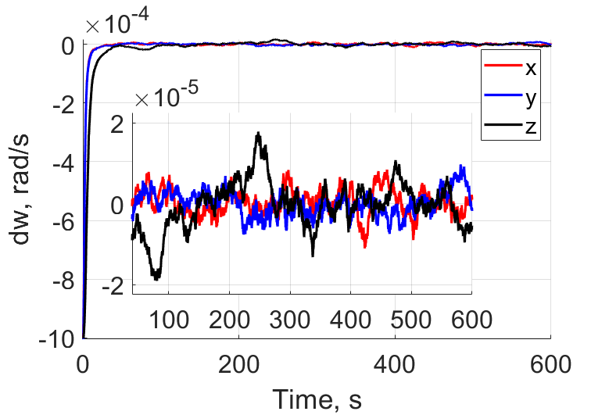
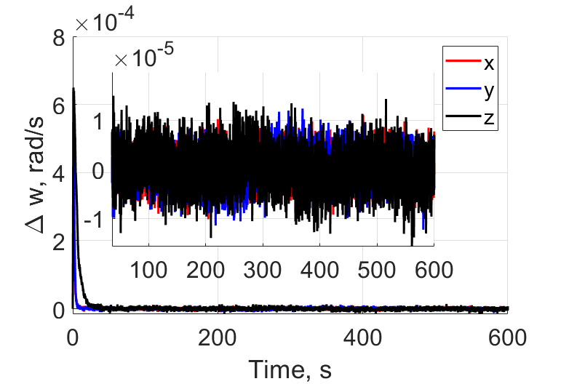
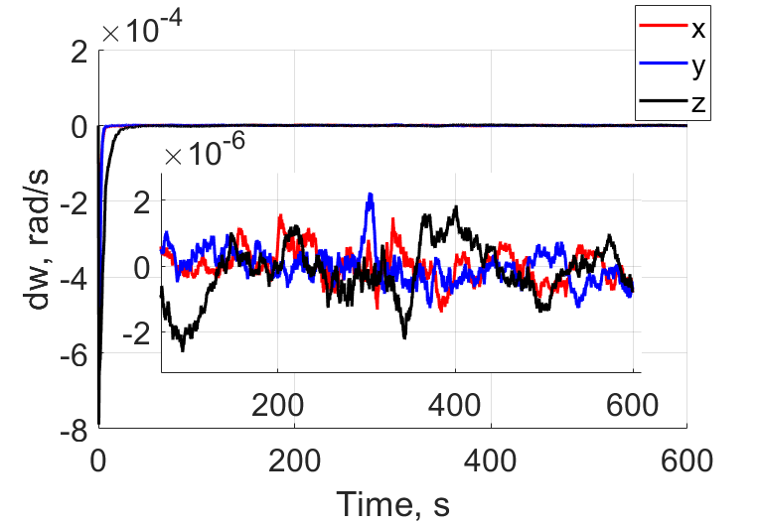
EKF performance
Attitude estimation error using kinematic EKF
Attitude estimation error using dynamic EKF
The performance of the dynamic EKF is better than kinematic EKF
Angular velocity
estimation errors
AVS bias
estimation errors
Angular velocity
estimation errors
AVS bias
estimation errors
10

Slide 11
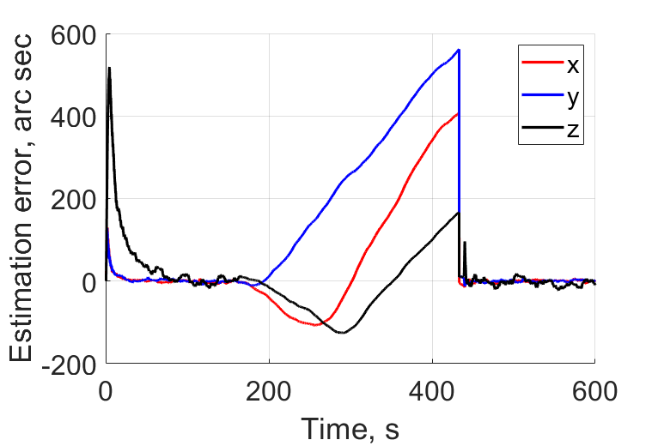
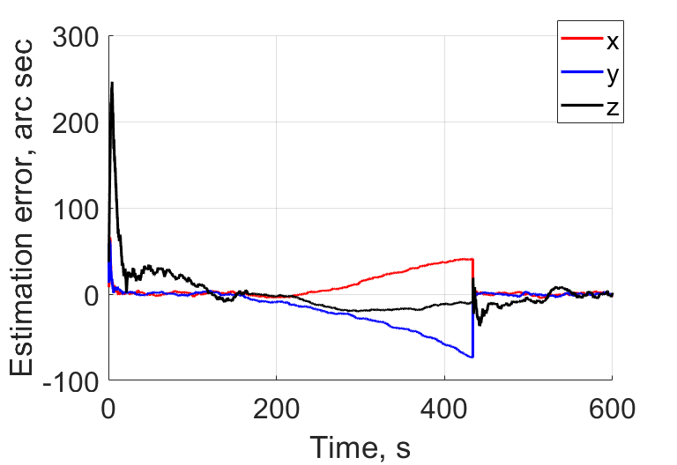
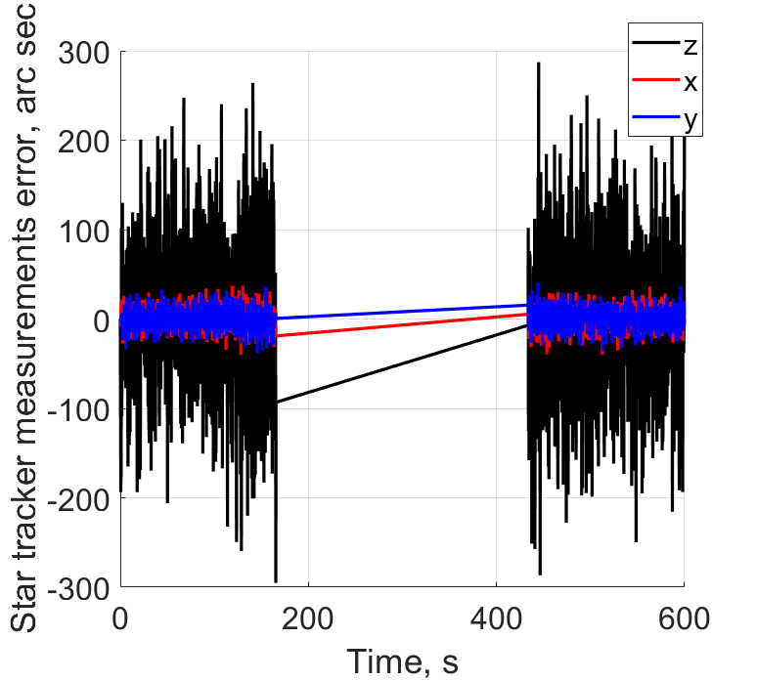
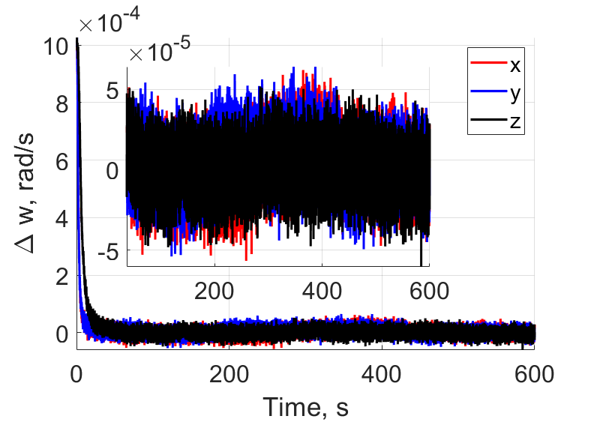
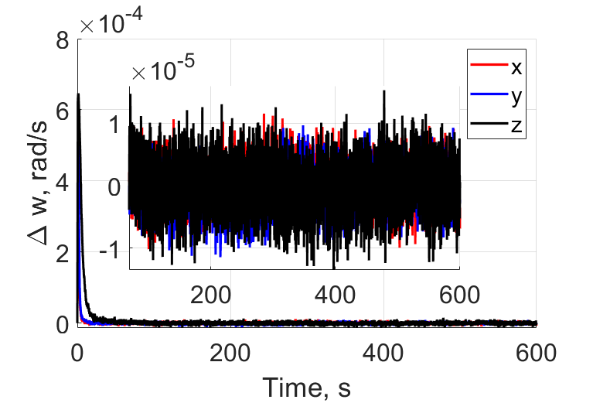
Not available star tracker measurements
Kinematic EKF errors
Dynamic EKF errors
When angular velocity is higher than 0.5 deg/s, the star tracker measurements are not available
The attitude is estimated using by AVS measurements only
Okay, Houston ...
we've had
a problem here
11

Slide 12
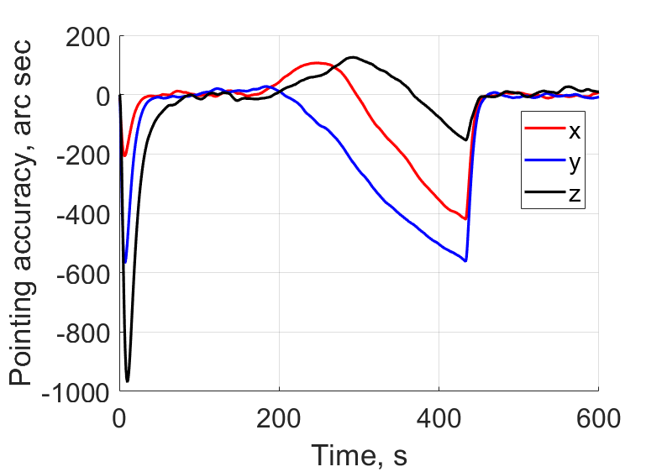
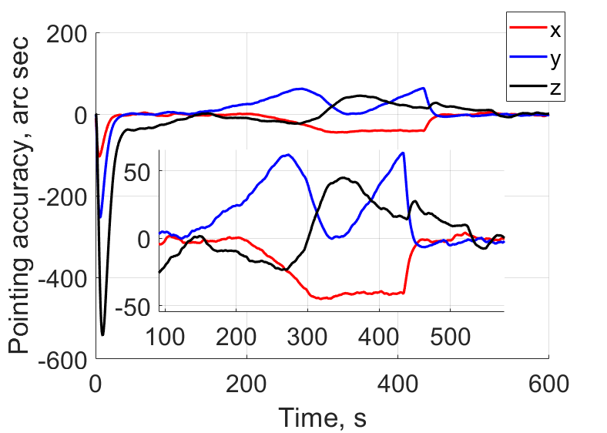
Pointing accuracy
The resulting pointing accuracy is calculated as difference between the reference frame attitude and satellite real attitude
The control implementation error due to inertia tensor uncertainty is also taken into account
Kinematic EKF
Dynamic EKF
12

Slide 13
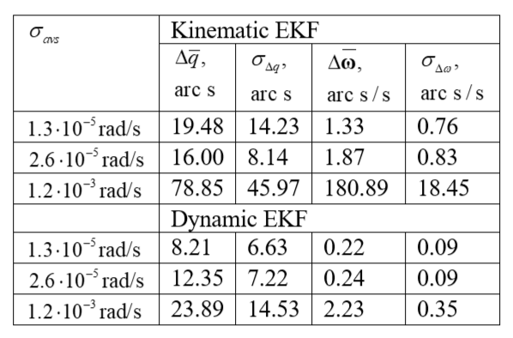
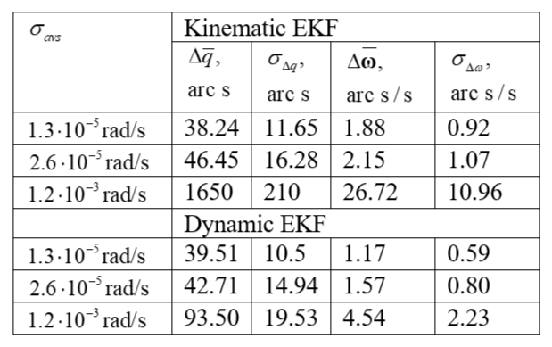
Performance comparison
Monte-Carlo simulations are carried out to study the algorithms performance using AVS with different set of noise levels
EKF accuracy
Earth-point stabilization accuracy
13

Slide 14
Conclusions
The EKF-based algorithms were described, whose state vector estimations are necessary for the implementation of the control law for Earth-point tracking
The estimation algorithms take into account the delay and non-synchronism of measurements, and they also allow for the loss of some measurements from the telemetry information
The dynamic EKF-based algorithm showed better performance, though it requires more computational burden than kinematic EKF
14

Slide 15
Thank you for the attention!
One does not simply
be precise
15

